Slide 1
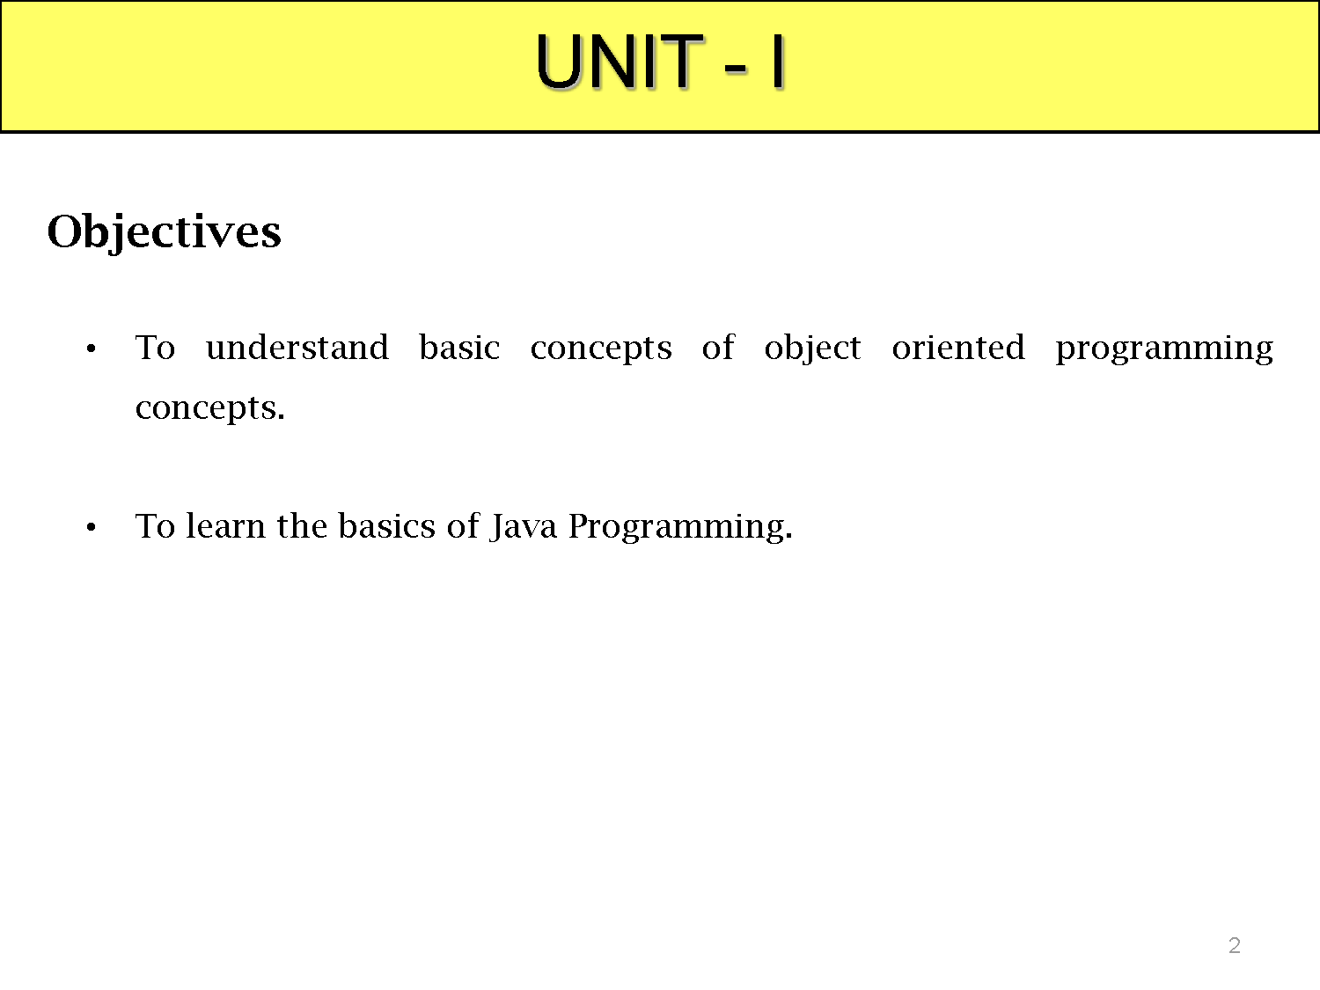

Slide 2
TOPICS
JAVA BASICS: Review of Object oriented concepts, History of Java, Java buzzwords, JVM architecture, Data types, Variables, Scope and life time of variables, arrays, operators, control statements, type conversion and casting, simple java program, constructors, methods, Static block, Static Data, Static Method String and String Buffer Classes, Using Java API Document.

Slide 3
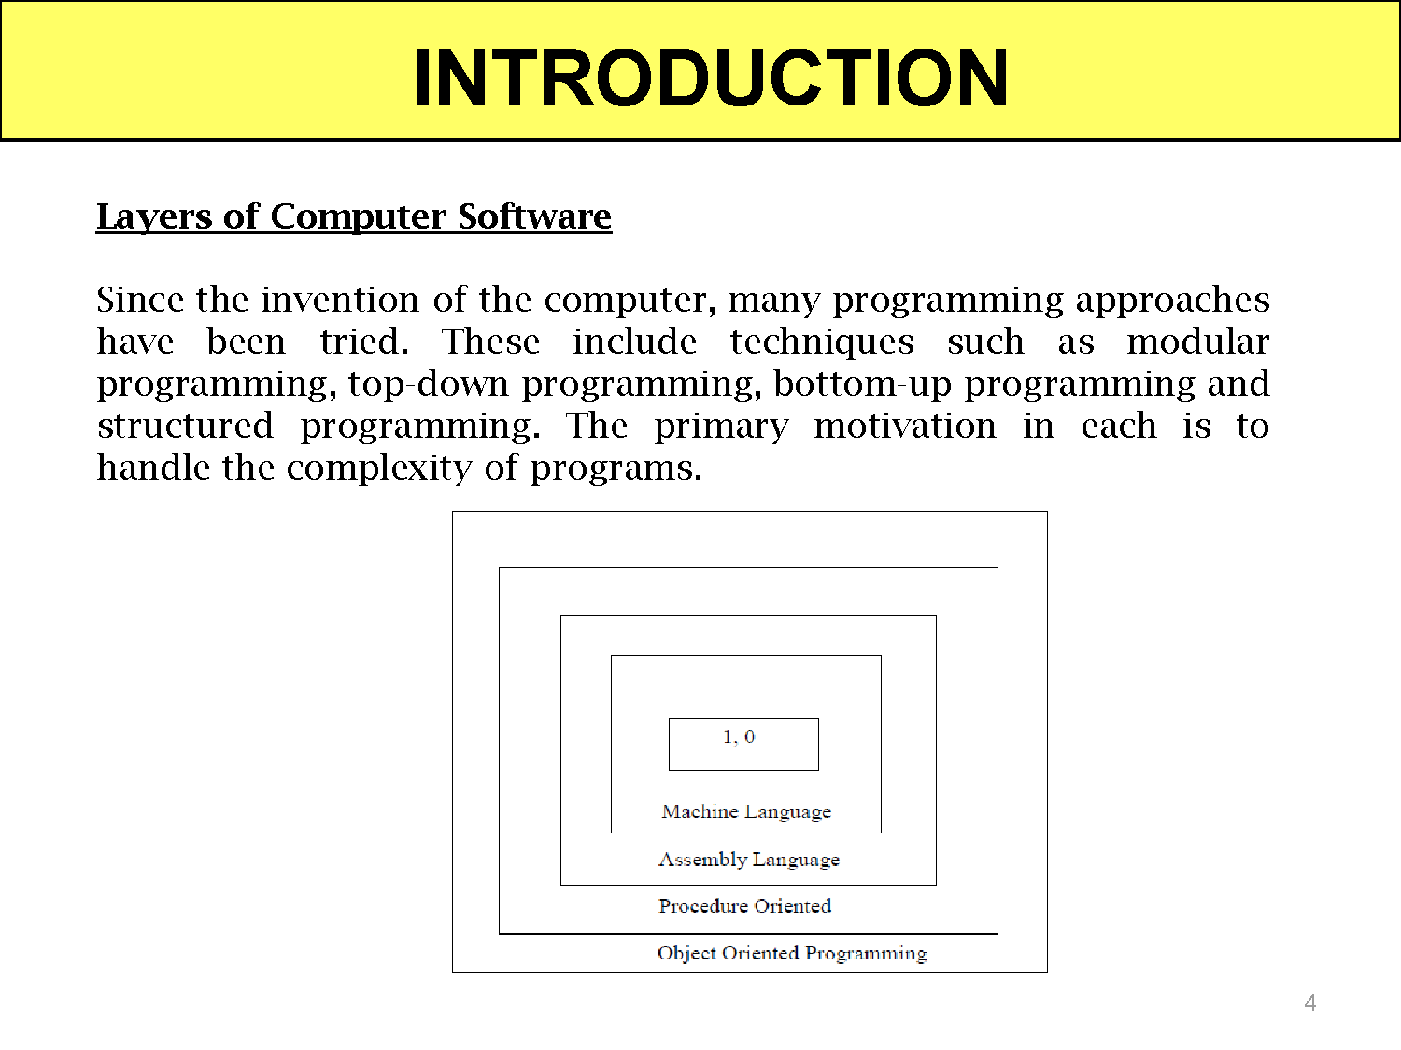

Slide 4
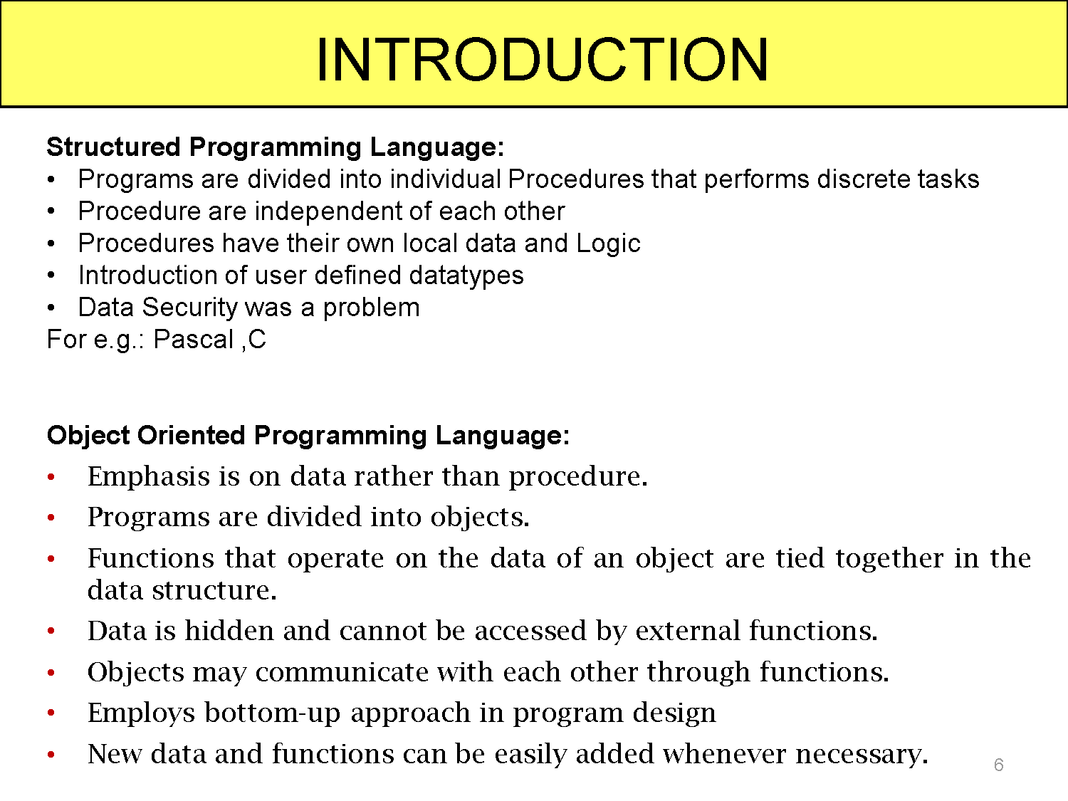

Slide 5
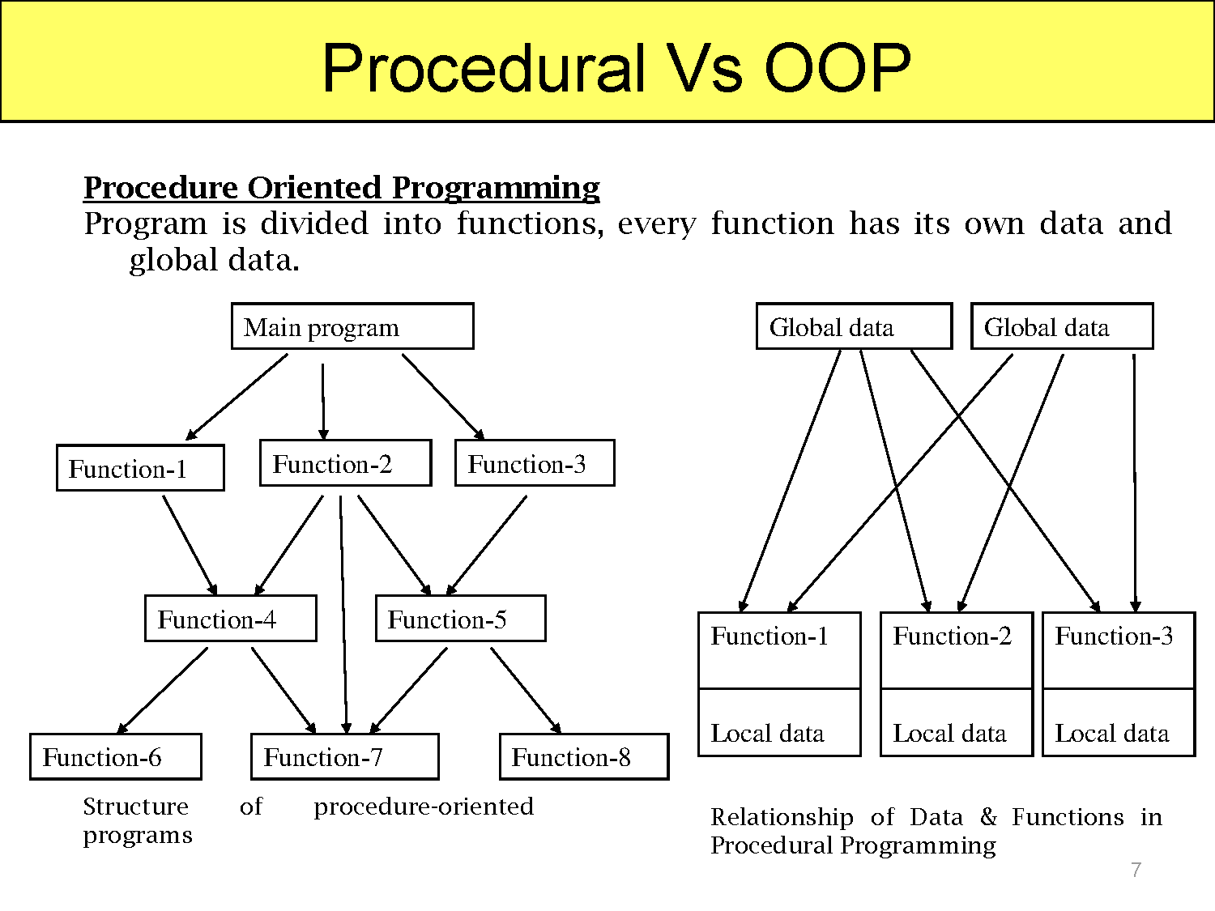

Slide 6
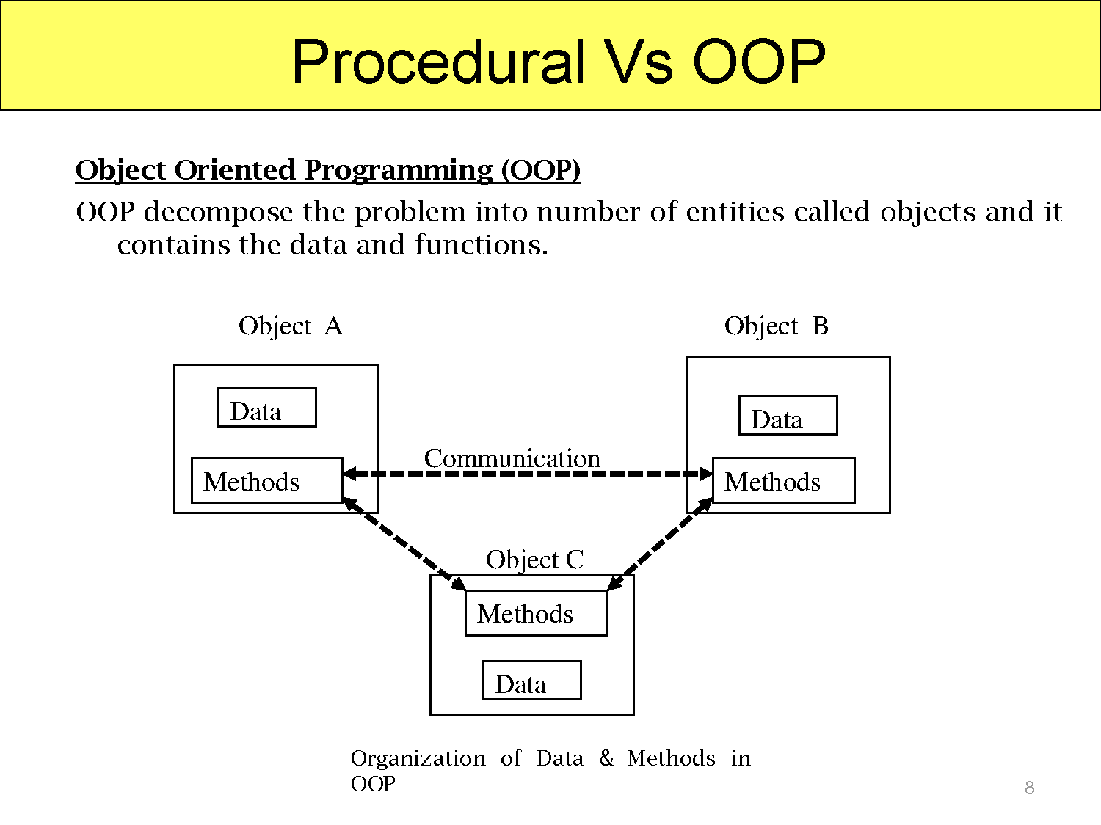

Slide 7
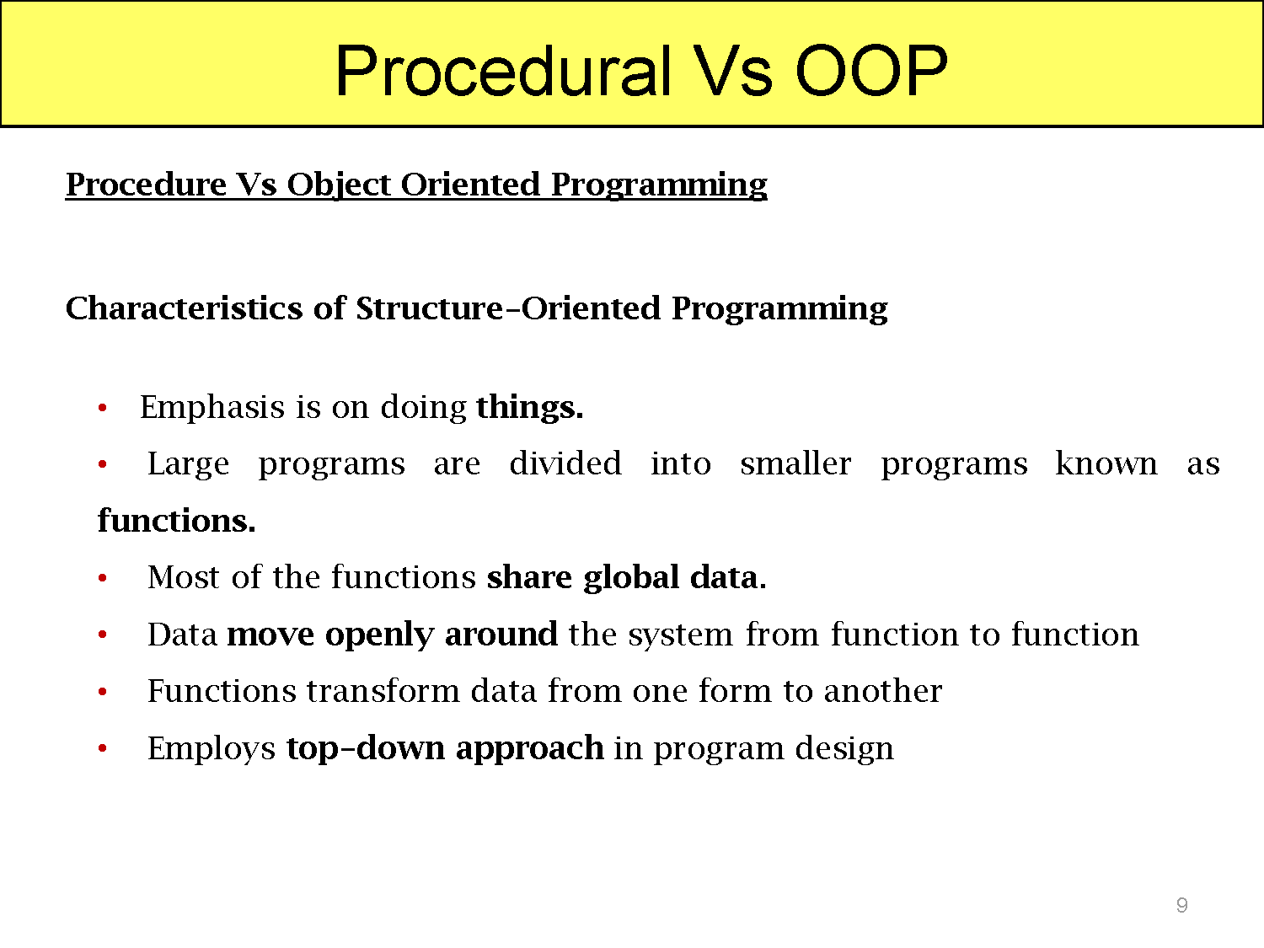

Slide 8
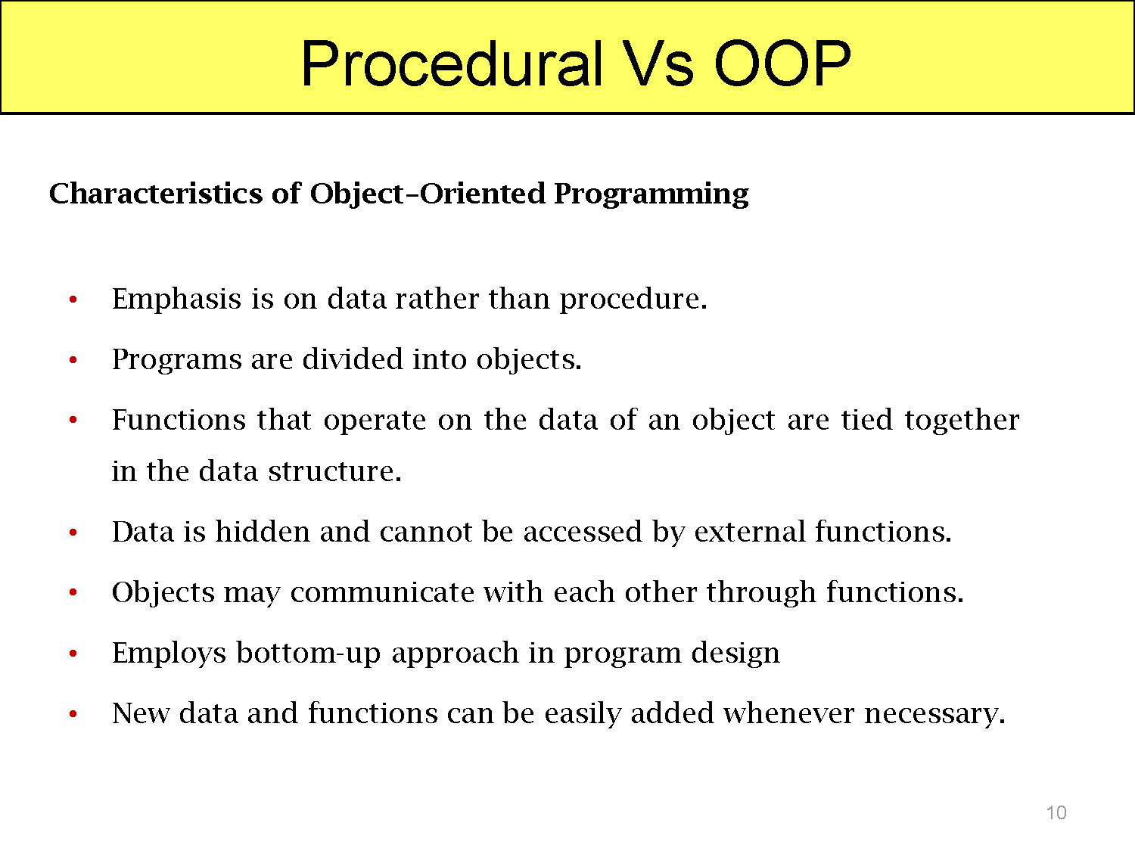

Slide 9
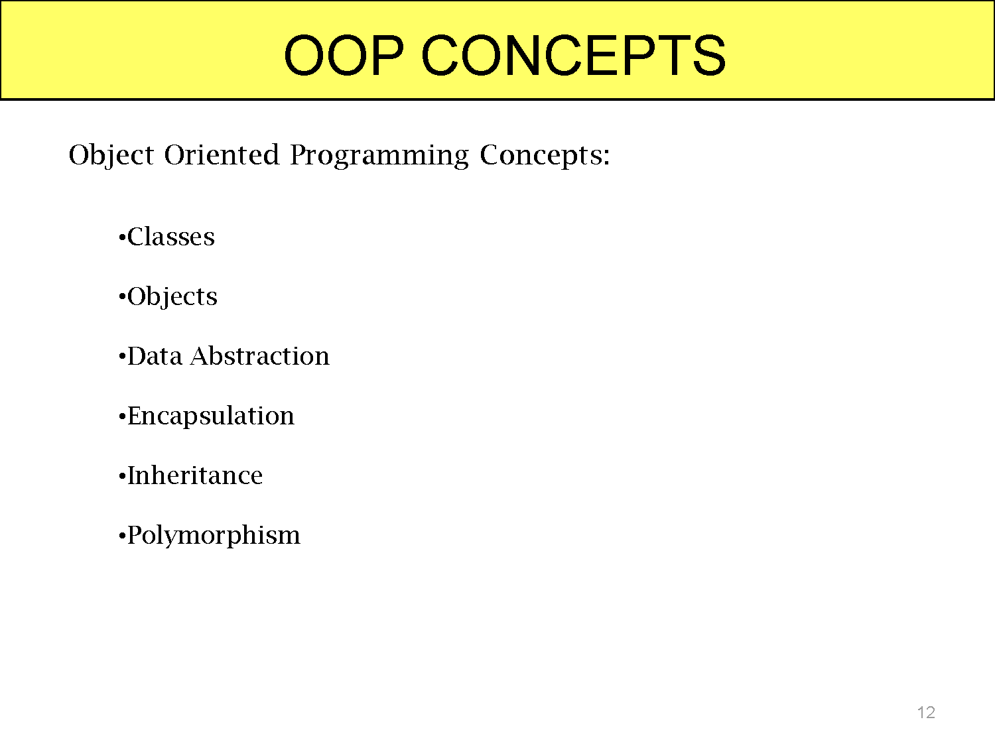

Slide 10
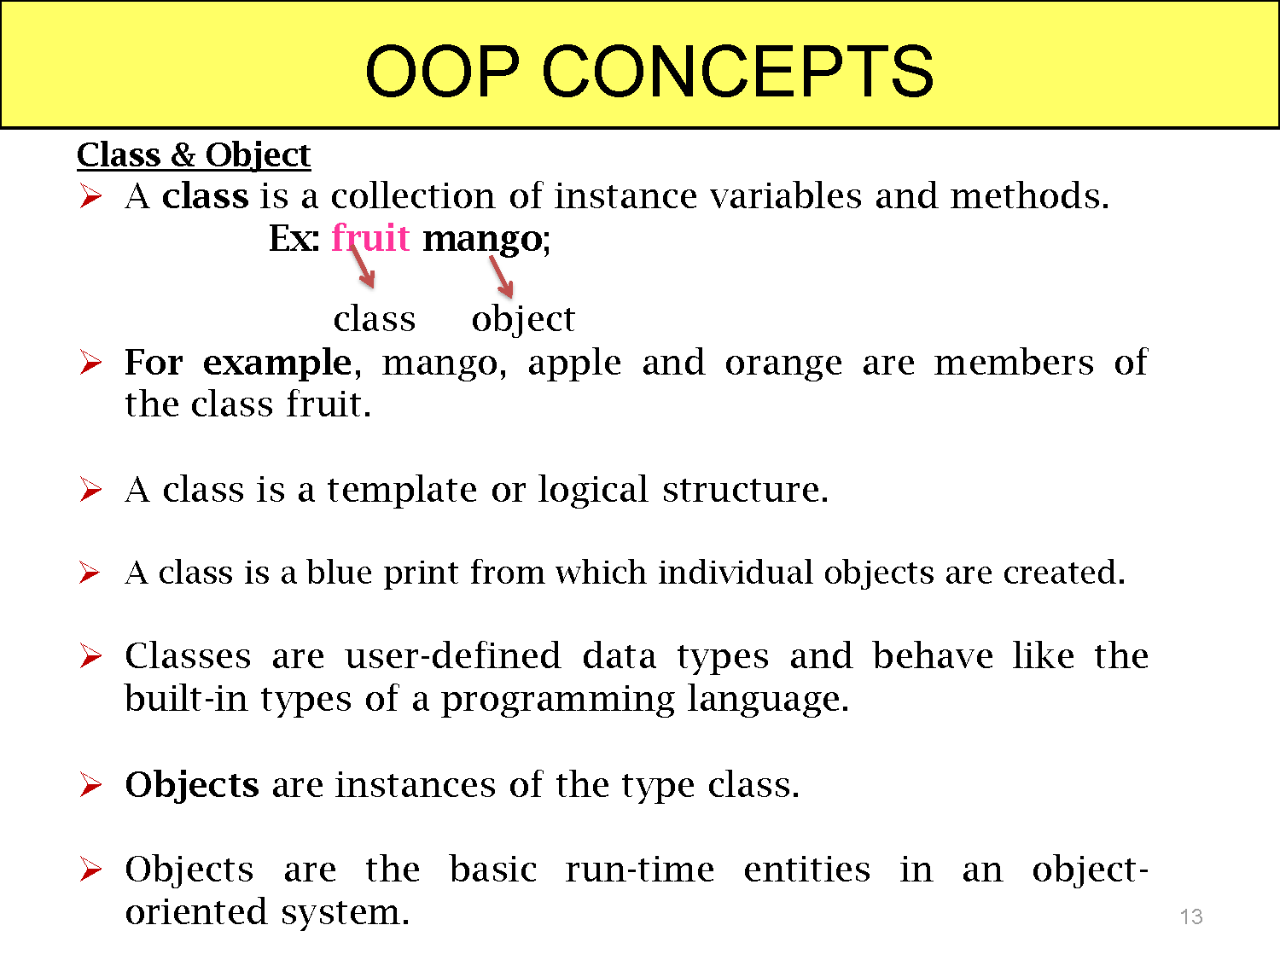

Slide 11
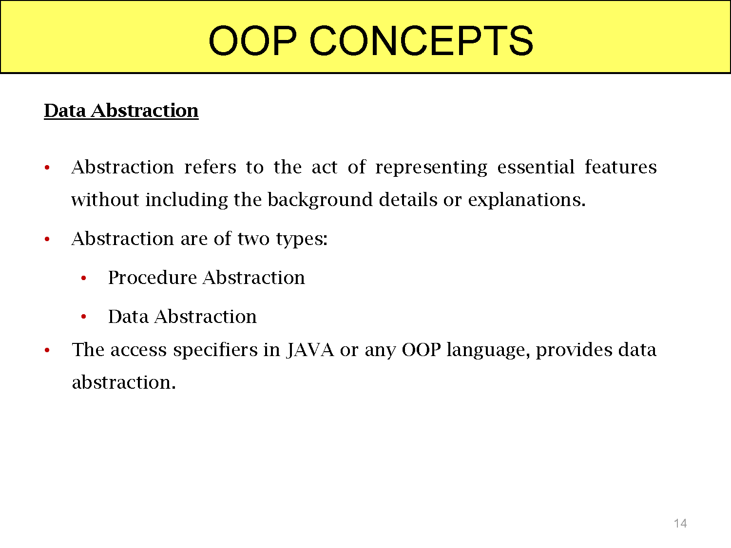

Slide 12
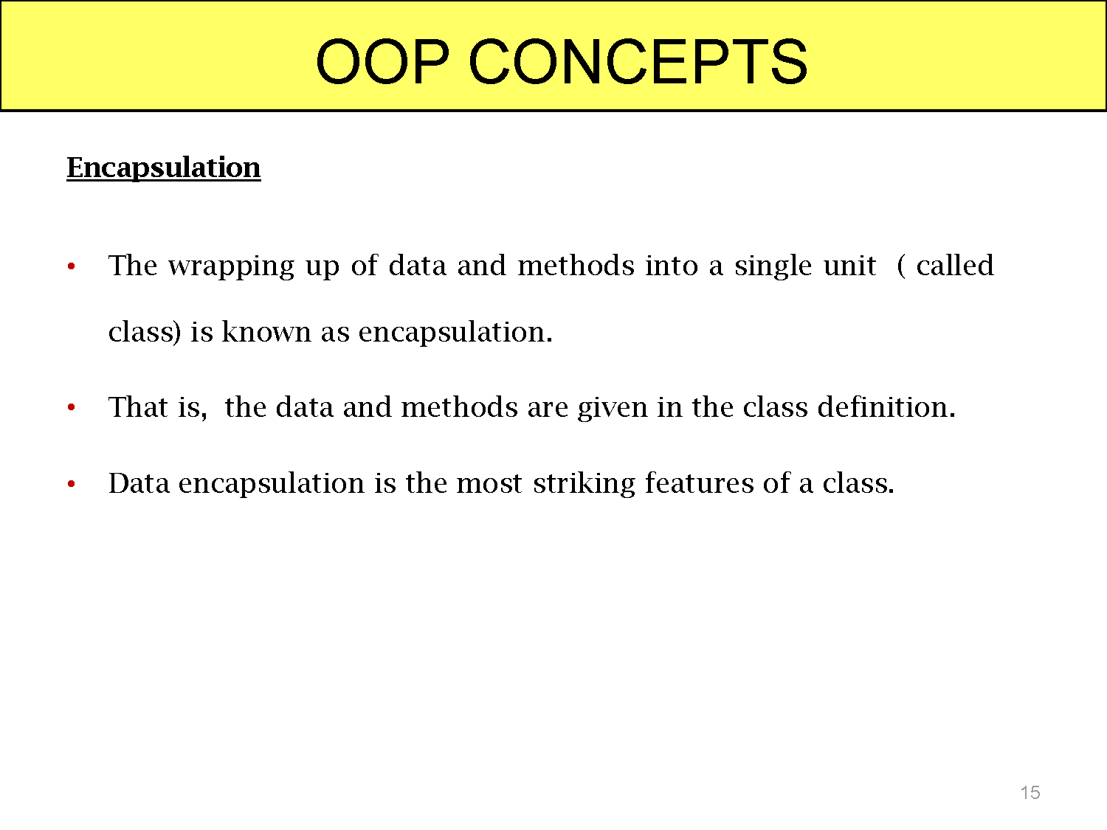

Slide 13
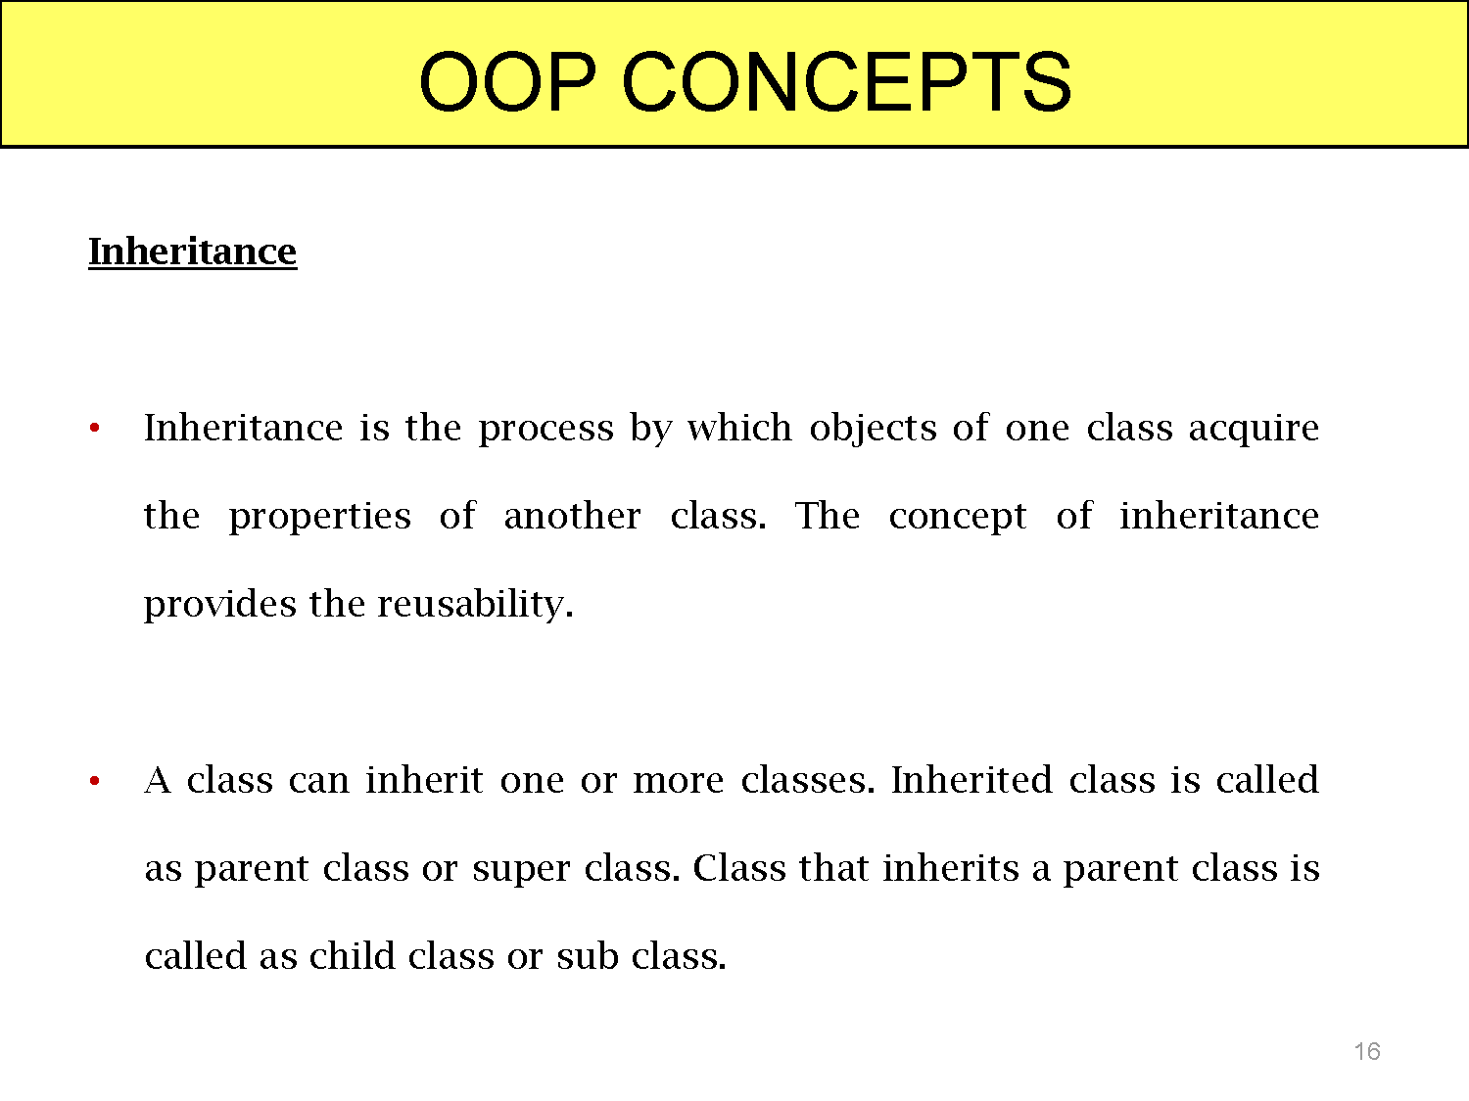

Slide 14
OOP CONCEPTS
Benefits of Inheritance
Software reusability (among projects) : Functions written once can be reused. No need to spend time in rewriting the code
Code sharing (within a project) : Many users and projects can use the same classes.
Increased reliability (resulting from reuse and sharing of well-tested code) : Probability of fewer bugs in already used and tested code.

Slide 15
OOP CONCEPTS
4) Polymorphism and frameworks (high-level reusable components): Polymorphism permits the programmer to generate high-level reusable components that can be tailored to fit different applications by changes in their low-level parts.
5) Information hiding : Reduces inter connections between software system thus decreasing software complexity.

Slide 16
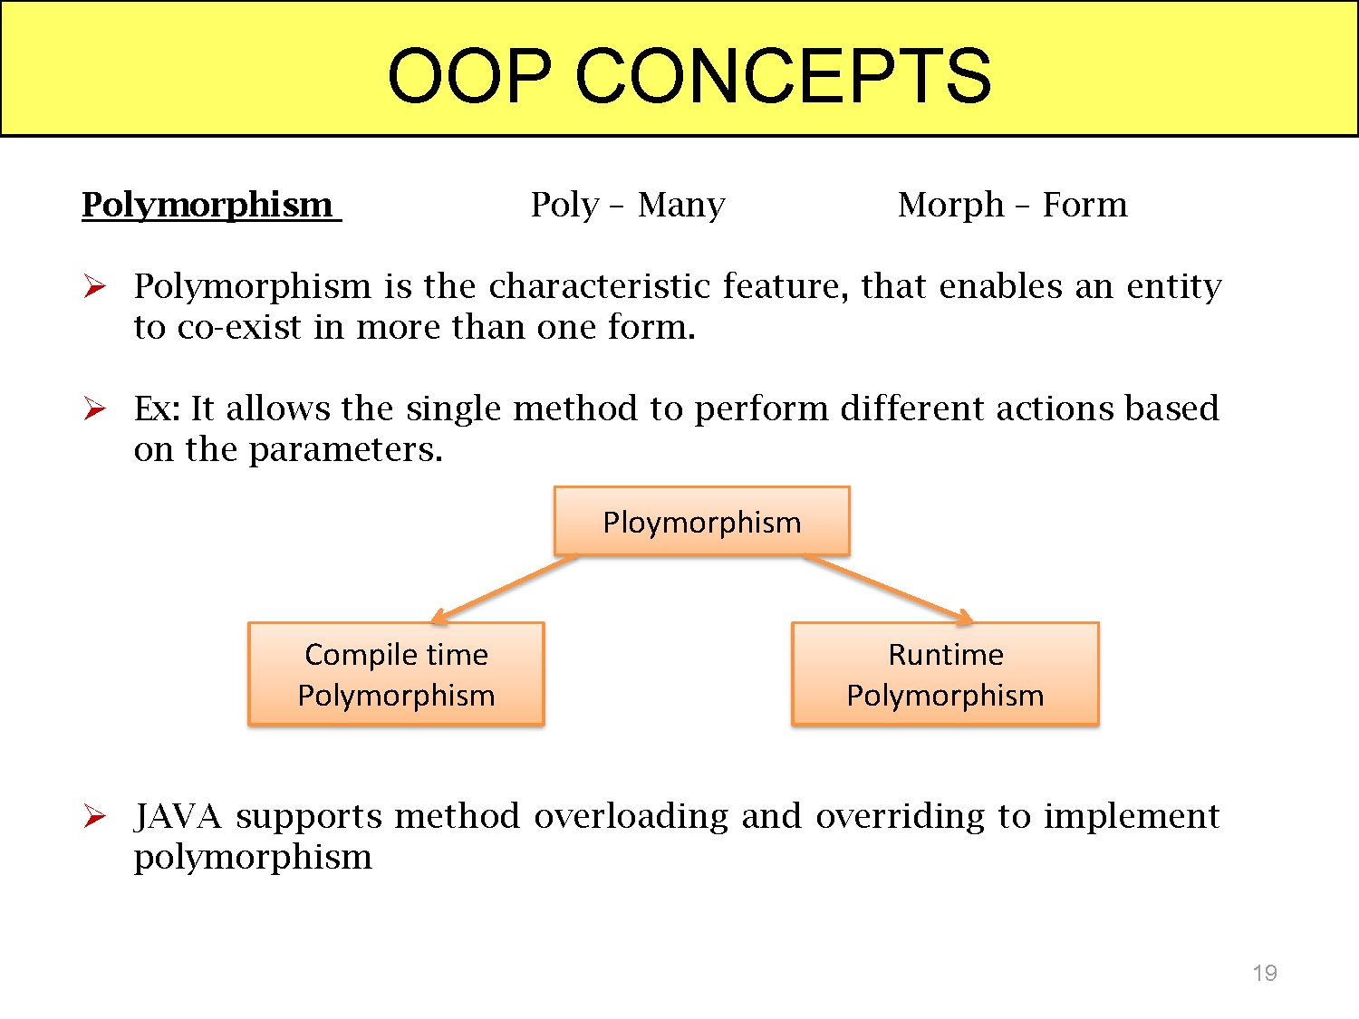

Slide 17
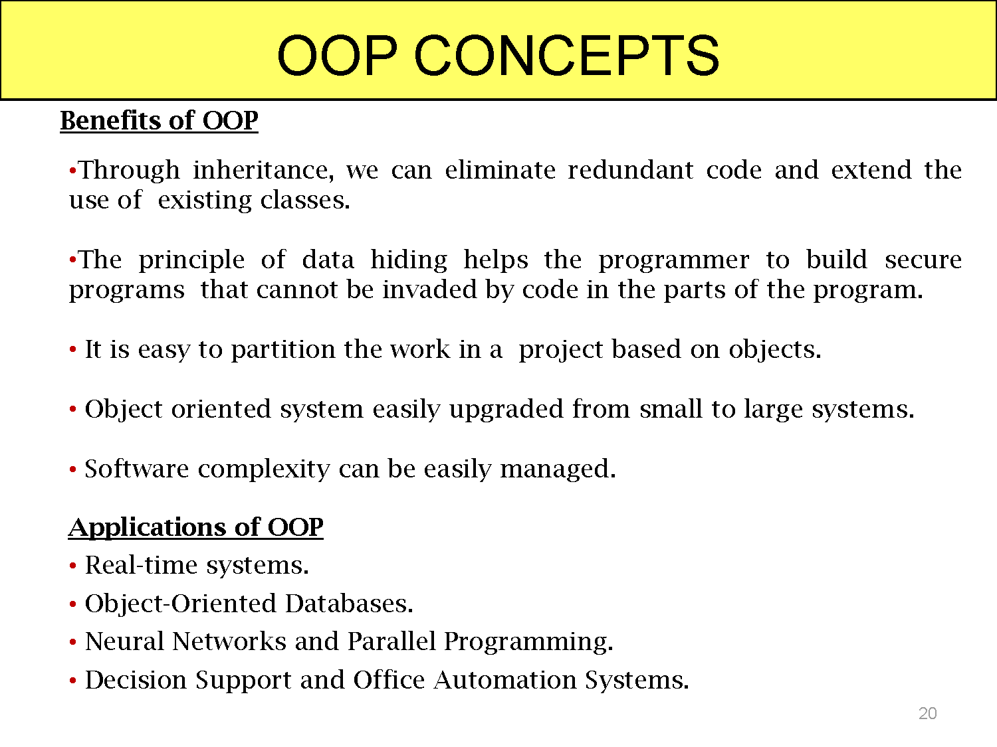

Slide 18
Java History
C language :
Designed by Dennis Ritchie in 1970s.
Before C: BASIC, COBOL, FORTRAN, PASCAL
C- structured, efficient, high-level language that could replace assembly code when creating systems programs.
Designed, implemented and tested by programmers.
C++ Language :
Designed by Bjarne Stroustrup in 1979.
Response to the increased complexity of programs and respective improvements in the programming paradigms and methods:
1) assembler languages
2) high-level languages
3) structured programming
4) object-oriented programming (OOP)
OOP – methodology that helps organize complex programs through the use of inheritance, encapsulation and polymorphism.
C++ extends C by adding object-oriented features

Slide 19
JAVA language :
Computer language innovation and development occurs for two fundamental reasons:
1) to adapt to changing environments and uses
2) to implement improvements in the art of programming
The development of Java was driven by both in equal measures.
Many Java features are inherited from the earlier languages:
B → C → C++ → Java

Slide 20
Java
In 1991, Sun Microsystems
Designed by James Gosling, Patrick Naughton, Chris Warth, Ed Frank and Mike Sheridan at Sun Microsystems in 1991.
The original motivation is not Internet: platform-independent software embedded in consumer electronics devices.
Java as an “Internet version of C++”? No.
Java was not designed to replace C++, but to solve a different set of problems.

Slide 21
The Java Buzzwords
The key considerations were summed up by the Java team in the following list of buzzwords:
Simple
Object-Oriented
Portable
Platform independent
Secured
Robust
Architecture neutral
Dynamic
Interpreted
High Performance
Multithreaded
Distributed

Slide 22
The Java Buzzwords
Simple: According to Sun, Java language is simple because:
syntax is based on C++ (so easier for programmers to learn it after C++).
removed many confusing and/or rarely-used features e.g., explicit pointers, operator overloading etc.
No need to remove unreferenced objects because there is Automatic Garbage Collection in java.

Slide 23
The Java Buzzwords
Object-oriented: Object-oriented means we organize our software as a combination of different types of objects that incorporates both data and behavior.
Platform Independent: Java code can be run on multiple platforms e.g. Windows, Linux, Sun Solaris, Mac/OS etc. Java code is compiled by the compiler and converted into bytecode.
This bytecode is a platform-independent code because it can be run on multiple platforms i.e. Write Once and Run Anywhere(WORA).

Slide 24
The Java Buzzwords
Secured: Java is secured because:
No explicit pointer
Java Programs run inside virtual machine
Robust: Robust simply means strong. Java uses strong memory management. There are lack of pointers that avoids security problem. There is automatic garbage collection in java. There is exception handling and type checking mechanism in java. All these points makes java robust.

Slide 25
The Java Buzzwords
Architecture-neutral
There is no implementation dependent features e.g. size of primitive types is fixed.
In C programming, int data type occupies 2 bytes of memory for 32-bit architecture and 4 bytes of memory for 64-bit architecture. But in java, it occupies 4 bytes of memory for both 32 and 64 bit architectures.
Portable
We may carry the java bytecode to any platform.

Slide 26
The Java Buzzwords
High-performance
Java is faster than traditional interpretation since byte code is "close" to native code still somewhat slower than a compiled language (e.g., C++).
Distributed
We can create distributed applications in java. RMI is used for creating distributed applications. We may access files by calling the methods from any machine on the internet.

Slide 27
The Java Buzzwords
Multi-threaded
A thread is like a separate program, executing concurrently. We can write Java programs that deal with many tasks at once by defining multiple threads. The main advantage of multi-threading is that it doesn't occupy memory for each thread. It shares a common memory area. Threads are important for multi-media, Web applications etc.

Slide 28
JVM Architecture
JVM(Java Virtual Machine) acts as a run-time engine to run Java applications. JVM is a part of JRE(Java Run Environment).
Java applications are called WORA (Write Once Run Everywhere). This means a programmer can develop Java code on one system and can expect it to run on any other Java enabled system without any adjustment. This is all possible because of JVM.

Slide 29
JVM Architecture
When we compile a .java file, a .class file (contains byte-code) with the same filename is generated by the Java compiler.
This .class file goes into various steps when we run it. These steps together describe the whole JVM.

Slide 30
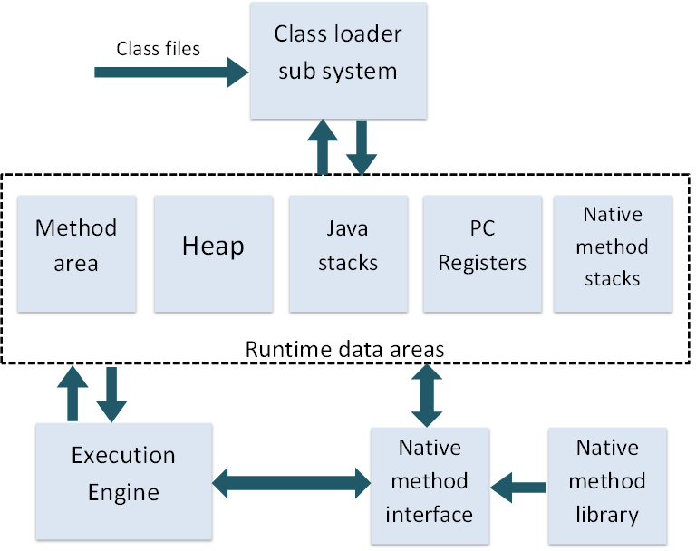
JVM Architecture

Slide 31
JVM Architecture
JVM is mainly responsible for three activities.
Loading
Linking
Initialization

Slide 32
JVM Architecture
Loading : The Class loader reads the .class file, generate the corresponding binary data and save it in method area. For each .class file, JVM stores following information in method area.
Fully qualified name of the loaded class and its immediate parent class.
Whether .class file is related to Class or Interface or Enum
Modifier, Variables and Method information etc.
After loading .class file, JVM creates an object of type Class to represent this file in the heap memory.

Slide 33
JVM Architecture
Linking : Performs verification, preparation, and (optionally) resolution.
Verification : It ensures the correctness of .class file i.e. it check whether this file is properly formatted and generated by valid compiler or not. If verification fails, we get run-time exception java.lang.VerifyError.
Preparation : JVM allocates memory for class variables and initializing the memory to default values.

Slide 34
JVM Architecture
Initialization : In this phase, all static variables are assigned with their values defined in the code and static block(if any). This is executed from top to bottom in a class and from parent to child in class hierarchy.

Slide 35
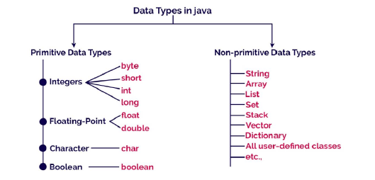
DATA TYPES IN JAVA
Java programming language has a rich set of data types. The data type is a category of data stored in variables. In java, data types are classified into two types and they are as follows.
Primitive Data Types
Non-primitive Data Types

Slide 36
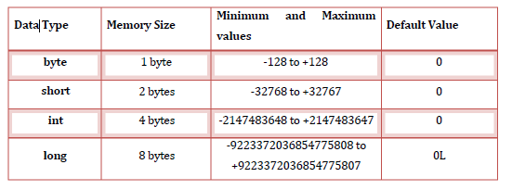
Primitive Data Types
The primitive data types are built-in data types and they specify the type of value stored in a variable and the memory size.
Integer Data Types
Integer Data Types represent integer numbers, i.e numbers without any fractional parts or decimal points.

Slide 37
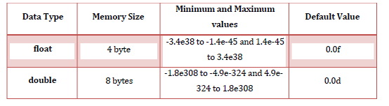
Float Data Types
Float data types are represent numbers with decimal point.
Note: Float data type can represent up to 7 digits accurately after decimal point.
Double data type can represent up to 15 digits accurately after decimal point.

Slide 38
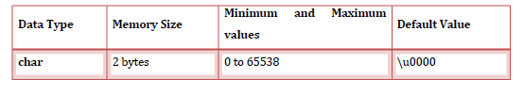

Character Data Type
Character data type are represents a single character like a, P, &, *,..etc.
Boolean Data Types
Boolean data types represent any of the two values, true or false. JVM uses 1 bit to represent a Boolean value internally.

Slide 39
VARIABLES
Variable is a name given to a memory location where we can store different values of the same data type during the program execution.
The following are the rules to specify a variable name...
A variable name may contain letters, digits and underscore symbol
Variable name should not start with digit.
Keywords should not be used as variable names.
Variable name should not contain any special symbols except underscore(_).
Variable name can be of any length but compiler considers only the first 31 characters of the variable name.

Slide 40
Declaration of Variable
Declaration of a variable tells to the compiler to allocate required amount of memory with specified variable name and allows only specified datatype values into that memory location.
Syntax: datatype variablename;
Example : int a;
Syntax : data_type variable_name_1, variable_name_2,...; Example : int a, b;
Initialization of a variable:
Syntax: datatype variablename = value;
Example : int a = 10;
Syntax : data_type variable_name_1=value, variable_name_2 = value;
Example : int a = 10, b = 20;

Slide 41
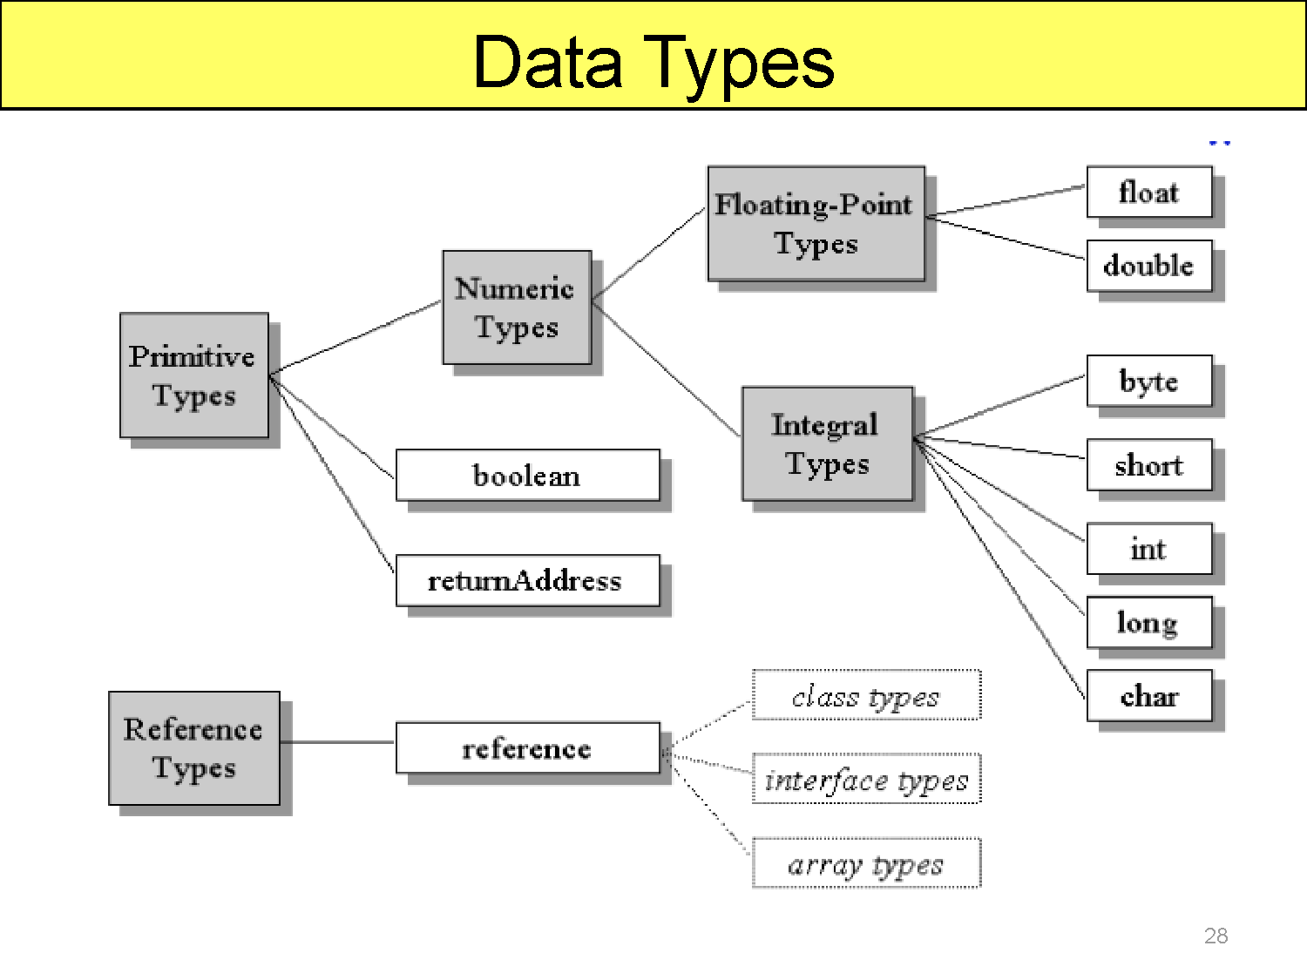

Slide 42
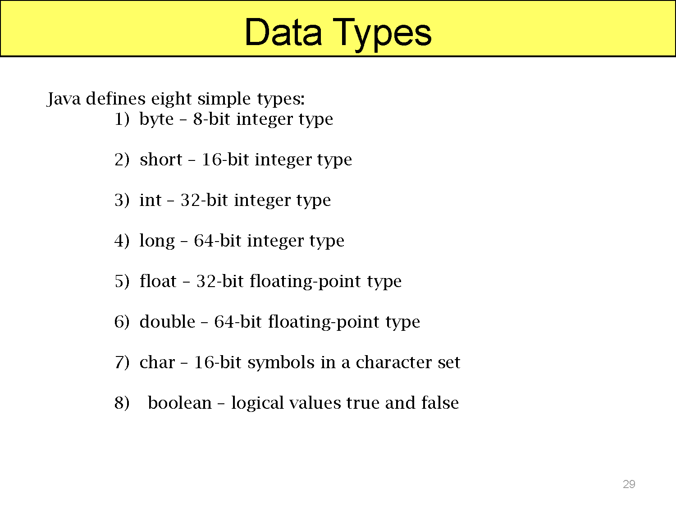

Slide 43
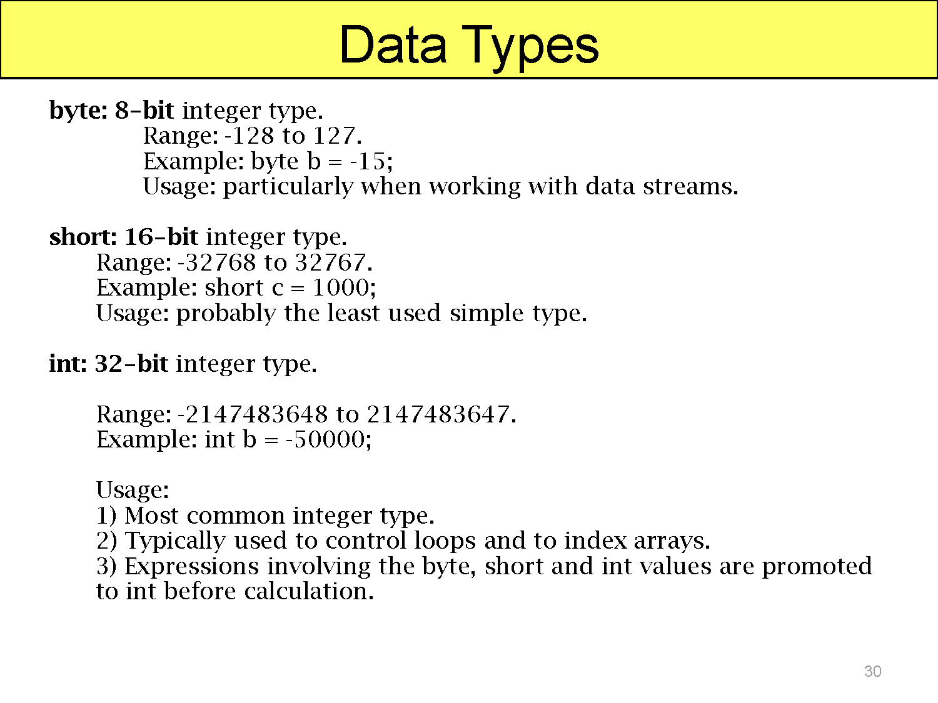

Slide 44
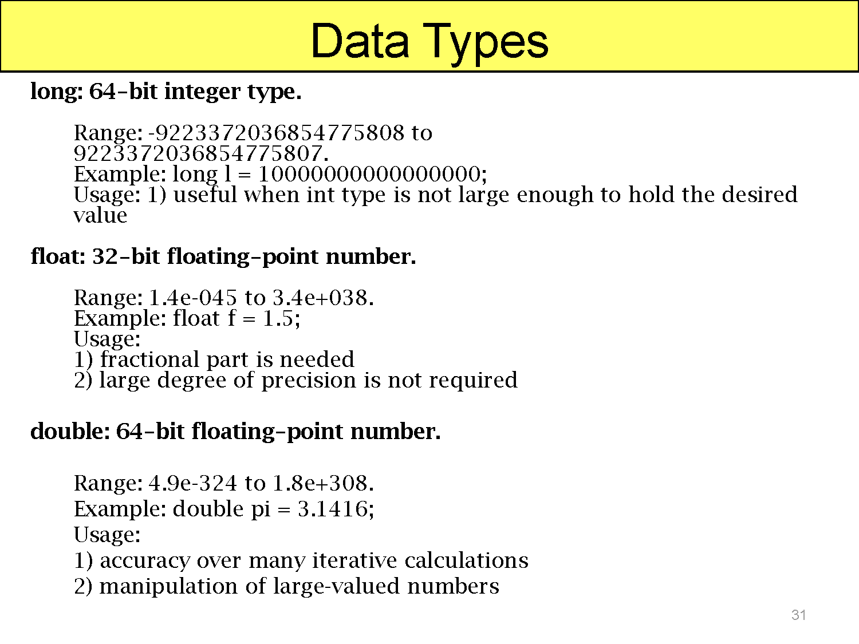

Slide 45
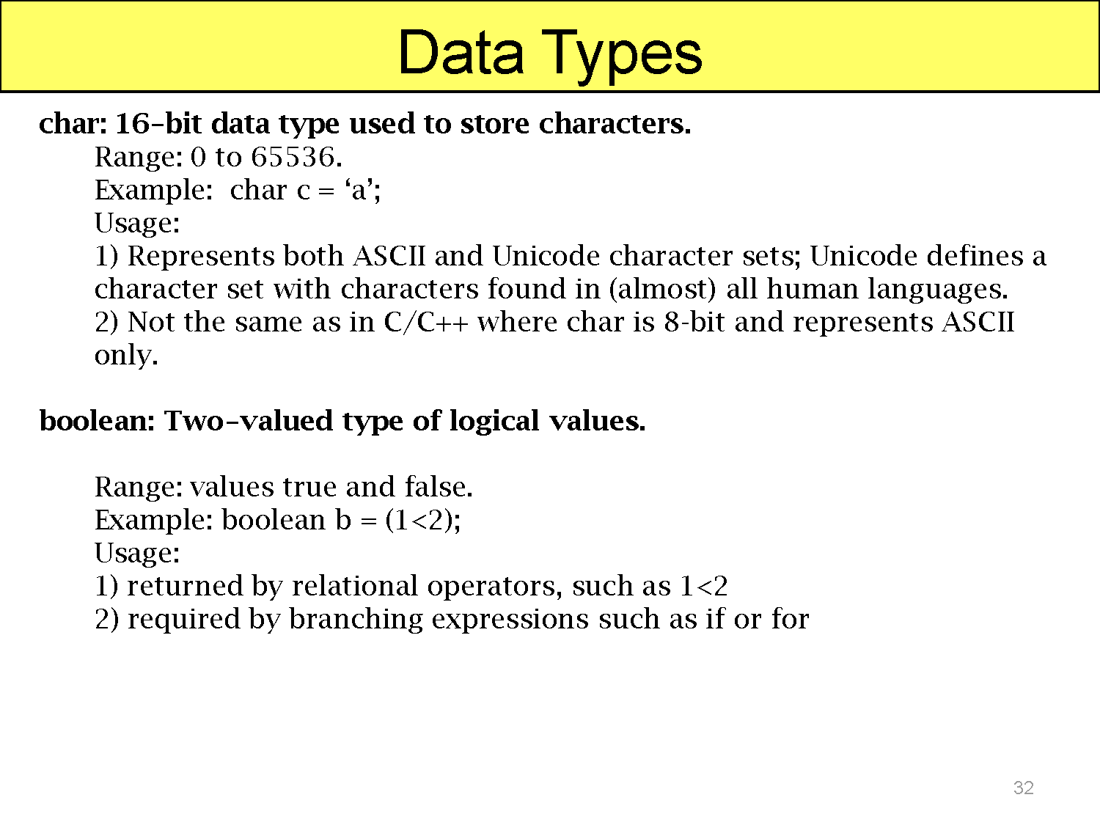

Slide 46
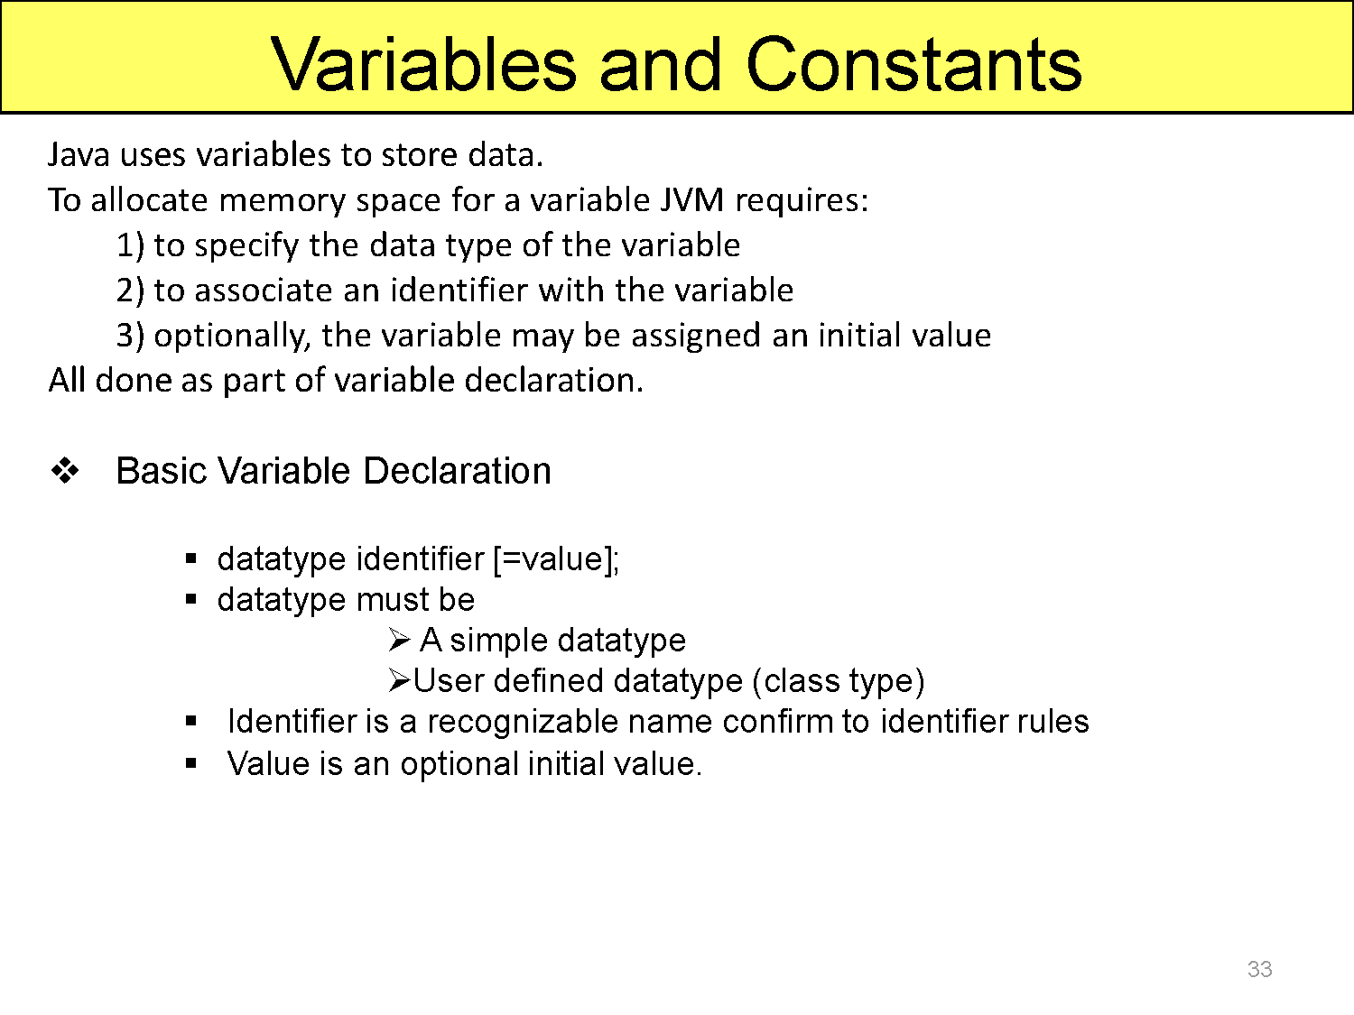

Slide 47
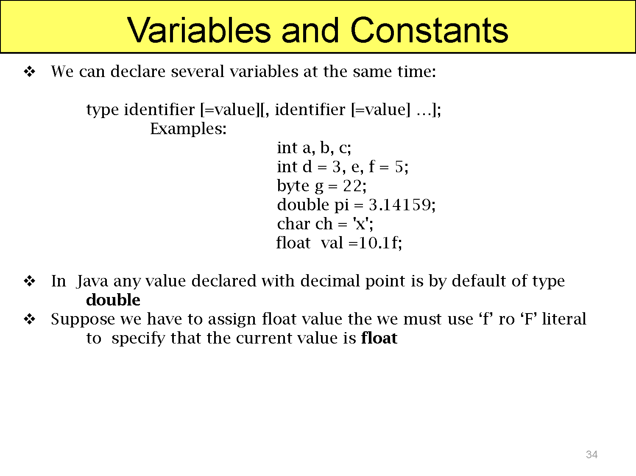

Slide 48
SCOPE AND LIFETIME OF A VARIABLE
In programming, a variable can be declared and defined inside a class, method, or block.
It defines the scope of the variable i.e. the visibility or accessibility of a variable.
Variable declared inside a block or method are not visible to outside.
If we try to do so, we will get a compilation error. Note that the scope of a variable can be nested.
Lifetime of a variable indicates how long the variable stays alive in the memory.

Slide 49
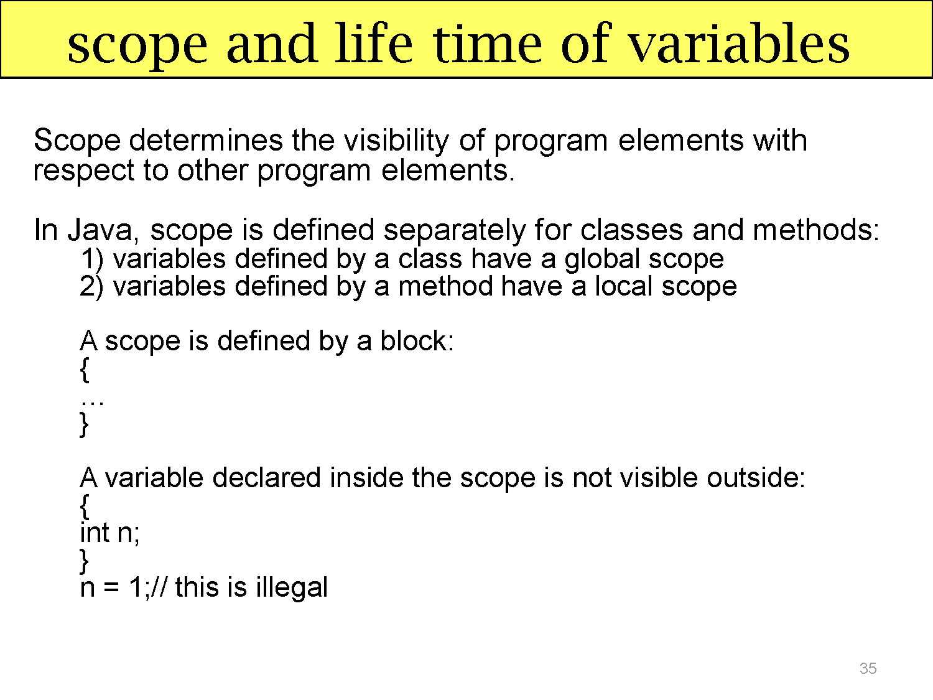

Slide 50
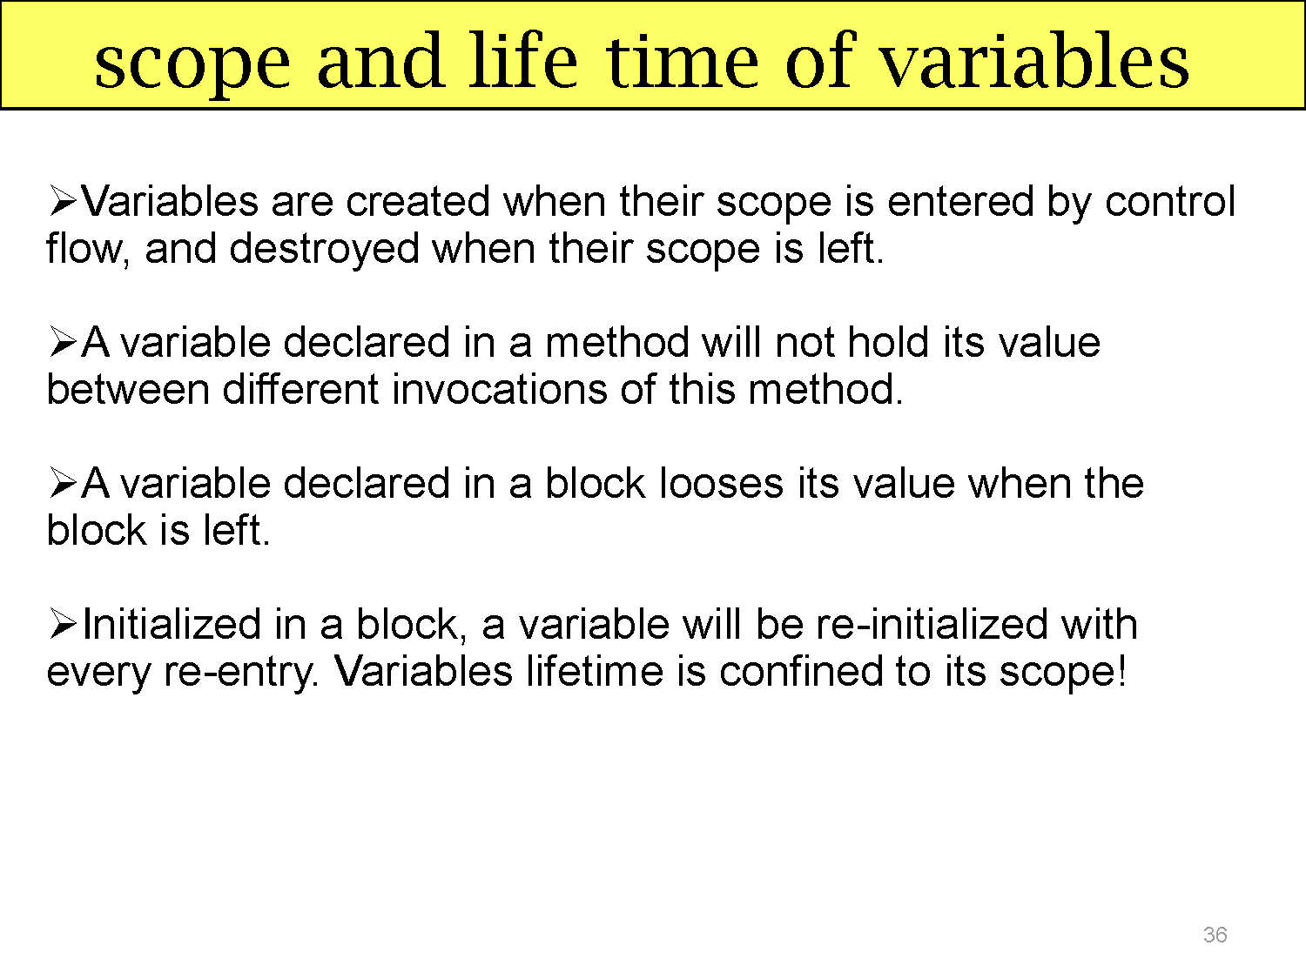

Slide 51
Main.java
public class Main {
public static void main(String[] args) {
System.out.println("Hello World");
}
}
Every line of code that runs in Java must be inside a class. The class name should always start with an uppercase first letter. In our example, we named the class Main.
Note: Java is case-sensitive. MyClass and myclass would be treated as two completely different names.

Slide 52
The name of the Java file must match the class name.
So if your class is called Main, the file must be saved as Main.java.
This is because Java uses the class name to find and run your code. If the names don't match, Java will give an error and the program will not run.
When saving the file, save it using the class name and add .java to the end of the filename

Slide 53
The main Method
The main() method is required in every Java program. It is where the program starts running:
public static void main(String[] args)
Each word in this statement grants specific permissions and behaviors to the JVM:
public (Access Modifier): Makes the method globally visible. The JVM must access this method from outside your program's class to start it.
static (Keyword): Allows the JVM to invoke the method directly on the class without instantiating it first. This saves memory because no object needs to be created just to start the application.
void (Return Type): Indicates that this method does not return any data or value once it finishes executing.
main (Method Name): The designated name the JVM explicitly searches for as the baseline starting point.
String[] args (Parameters): An array of text strings that lets you pass command-line arguments into your program when you launch it.

Slide 54
built-in command System.out.println(...)
This is the built-in command to print text onto your screen.
System: A pre-built class that holds system utilities.
out: The output stream directed to your console.
println: Short for "print line." It displays the text and moves the cursor to the next line.
Steps to Implement a Java Program
Java is a platform-independent language that follows a two-step execution process:
Compilation (source code -> bytecode)
Execution (bytecode -> machine code via JVM)

Slide 55
Scanner class
To read a value from the keyboard in Java, the easiest and most common way is to use the Scanner class from the java.util package.
Essential Scanner Methods
Depending on what type of data you want to collect…
nextLine(): Reads a whole line of text.
next(): Reads just a single word (stops at the first space).
nextInt(): Reads a whole number (int).
nextDouble(): Reads a decimal number (double).
nextBoolean(): Reads a true or false value.

Slide 56
Program :- To print a message on the screen.
Create a class.
Define the main() method.
Use System.out.println() to print the message.
public class HelloWorld {
public static void main(String[] args) {
System.out.println("Hello, World!");
}
}

Slide 57
public class HelloWorld {
public static void main(String[] args) {
System.out.println("Hello, World!");
}
}
Explanation
public class HelloWorld creates a class named HelloWorld.
public static void main(String[] args) is the entry point of every Java program.
System.out.println() prints text on the console and moves the cursor to the next line.
System is a predefined class in the java.lang package.
out is a static object of the PrintStream class.
println() is a method of the PrintStream class.

Slide 58
Program – 2:- To add two integers entered by the user.
Import the Scanner class.
Read two numbers from the keyboard.
Add the numbers.
Display the result.

Slide 59
Scanner sc = new Scanner(System.in);
Scanner
Scanner is a predefined class in the java.util package.
It is used to read different types of input such as integers, floating-point numbers, characters, words, and strings from the user.
Before using Scanner, you must import it:
import java.util.Scanner; (or)
Import java.util.*;
Sc
sc is the reference variable (or object name).
It refers to the Scanner object.
You can choose any valid name instead of sc, such as input or scanner.

Slide 60
Scanner sc = new Scanner(System.in);
3) new
new is a Java keyword used to create an object.
It allocates memory for the object and calls the constructor of the class.
4) Scanner(System.in)
Scanner() is the constructor of the Scanner class.
System.in represents the standard input stream, which is usually the keyboard.
Passing System.in to the constructor tells the Scanner to read input from the keyboard.

Slide 61
Keyboard
│
▼
System.in
│
▼
Scanner Object (sc)
│
▼
Reads user input

Slide 62
//1 Import the Scanner class.
import java.util.Scanner;
public class Addition {
public static void main(String[] args) {
//2 Read two numbers from the keyboard.
//Creates a Scanner object to read keyboard input.
Scanner sc = new Scanner(System.in);
System.out.print("Enter first number: ");
int a = sc.nextInt();
System.out.print("Enter second number: ");
int b = sc.nextInt();
//3 Add the numbers.
int sum = a + b;
// 4 Display the result.
System.out.println("Sum = " + sum);
}
}

Slide 63
Program 3:- To swap two numbers using a temporary variable.
public class Swap {
public static void main(String[] args) {
int a = 10;
int b = 20;
int temp;
temp = a;
a = b;
b = temp;
// "a = “ This is a String literal. It prints the text exactly as written.
// “ +” -- The + operator is used for string concatenation when one operand is a string.
It joins the string "a = " with the value stored in the variable a.
System.out.println("a = " + a);
System.out.println("b = " + b);
}
}

Slide 64
Program : To determine whether a number is even or odd.
import java.util.Scanner;
public class EvenOdd {
public static void main(String[] args) {
Scanner sc = new Scanner(System.in);
System.out.print("Enter a number: ");
int n = sc.nextInt();
if (n % 2 == 0)
System.out.println("Even Number");
else
System.out.println("Odd Number");
}
}

Slide 65
Program: To calculate the factorial of a given number. n! = n × (n−1) × (n−2) × ... × 1
import java.util.Scanner;
public class Factorial {
public static void main(String[] args) {
Scanner sc = new Scanner(System.in);
System.out.print("Enter a number: ");
int n = sc.nextInt();
int fact = 1;
for (int i = 1; i <= n; i++) {
fact = fact * i;
}
System.out.println("Factorial = " + fact);
}
}

Slide 66
Program:- To print the Fibonacci series.
import java.util.Scanner;
public class Fibonacci {
public static void main(String[] args) {
Scanner sc = new Scanner(System.in);
System.out.print("Enter number of terms: ");
int n = sc.nextInt();
int a = 0;
int b = 1;
for (int i = 1; i <= n; i++) {
System.out.print(a + " ");
int c = a + b;
a = b;
b = c;
}
}
}

Slide 67
Program: To check whether a number is prime.
import java.util.Scanner;
public class Prime {
public static void main(String[] args) {
Scanner sc = new Scanner(System.in);
System.out.print("Enter a number: ");
int n = sc.nextInt();
boolean prime = true;
if (n <= 1)
prime = false;
for (int i = 2; i <= Math.sqrt(n); i++) {
if (n % i == 0) {
prime = false;
break;
}
}
if (prime)
System.out.println("Prime Number");
else
System.out.println("Not Prime");
}
}

Slide 68
Program : To reverse the digits of a number.
import java.util.Scanner;
public class ReverseNumber {
public static void main(String[] args) {
Scanner sc = new Scanner(System.in);
System.out.println("Enter Number:");
int n = sc.nextInt();
int reverse = 0;
while (n != 0) {
reverse = reverse * 10 + n % 10;
n = n / 10;
}
System.out.println(reverse);
}
}

Slide 69
ARRAYS
An array is a collection of similar data values with a single name.
An array can also be defined as, a special type of variable that holds multiple values of the same data type at a time.
In java, arrays are objects and they are created dynamically using new operator.
Every array in java is organized using index values.
The index value of an array starts with '0' and ends with ‘size -1'.
We use the index value to access individual elements of an array.
In java, there are two types of arrays and they are as follows.
One Dimensional Array
Multi Dimensional Array

Slide 70
One Dimensional Array
In the java programming language, an array must be created using new operator and with a specific size.
The size must be an integer value but not a byte, short, or long. We use the following syntax to create an array.
Syntax
data_type array_name[ ] = new data_type[size];
(or)
data_type[ ] array_name = new data_type[size];

Slide 71
In java, an array can also be initialized at the time of its declaration.
When an array is initialized at the time of its declaration, it need not specify the size of the array and use of the new operator.
Here.., the size is automatically decided based on the number of values that are initialized.
Example
int list[ ] = {10, 20, 30, 40, 50};

Slide 72
Example
class Onedarray
{
public static void main(String args[])
{
Int a[]= new int [5];
a[0]=10;
a[1]=20;
a[2]=70;
a[3]=40;
a[4]=50;
for(int i=0;i<5;i++)
System.out.println(a[i]);
}
}

Slide 73
Multidimensional Array
In java, we can create an array with multiple dimensions. We can create 2-dimensional, 3-dimensional, or any dimensional array.
In Java, multidimensional arrays are arrays of arrays.
To create a multidimensional array variable, specify each additional index using another set of square brackets.
Syntax
data_type array_name[ ][ ] = new data_type[rows][columns];
(or)
data_type [ ][ ]array_name = new data_type[rows][columns];
When an array is initialized at the time of declaration, it need not specify the size of the array and use of the new operator.
Here, the size is automatically decided based on the number of values that are initialized.

Slide 74
Example
public class Twodarray {
public static void main(String args[])
{
int arr[][] = {{1,2,3},{4,5,6},{7,8,9}};
for(int i=0;i<3;i++)
{
for( int j=0;j<3;j++)
{
System.out.print(arr[i][j]+" ");
}
System.out.println();
}
}
}

Slide 75
OPERATORS
An operator is a symbol that performs an operation. An operator acts on some variables called operands to get the desired result.
Example: a + b
Here a, b are operands and + is operator.
Types of Operators
1. Arithmetic operators
2. Relational operators
3. Logical operators
4. Assignment operators
5. Increment or Decrement operators
6. Conditional operator
7. Bit wise operators

Slide 76
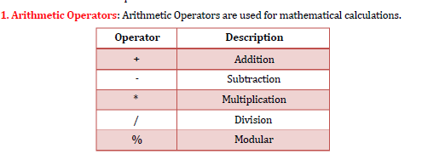
Program: Java Program to implement Arithmetic Operators
class ArithmeticOperators
{
public static void main(String[] args)
{
int a = 12, b = 5;
System.out.println("a + b = " + (a + b));
System.out.println("a - b = " + (a - b));
System.out.println("a * b = " + (a * b));
System.out.println("a / b = " + (a / b));
System.out.println("a % b = " + (a % b));
}
}

Slide 77
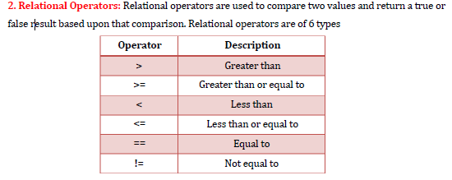
Program: Java Program to implement Relational Operators
class RelationalOperator
{
public static void main(String[] args)
{
int a = 10; int b = 3; int c = 5;
System.out.println("a > b: " + (a > b));
System.out.println("a < b: " + (a < b));
System.out.println("a >= b: " + (a >= b));
System.out.println("a <= b: " + (a <= b));
System.out.println("a == c: " + (a == c));
System.out.println("a != c: " + (a != c));
}
}

Slide 78
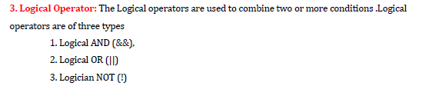
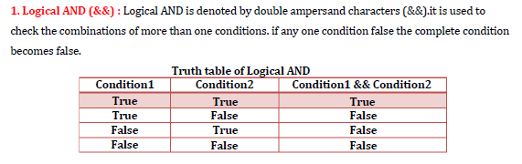

Slide 79
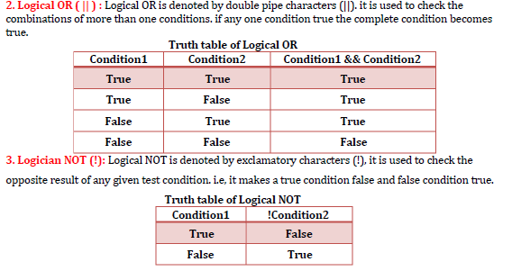

Slide 80
Example of Logical Operators
class LogicalOp
{
public static void main(String[] args)
{
int x=10;
System.out.println(x==10 && x>=5);
System.out.println(x==10 || x>=5);
System.out.println ( ! ( x==10 ));
}
}

Slide 81
4. Assignment Operator: Assignment operators are used to assign a value (or) an expression (or) a
value of a variable to another variable.
Syntax : variable name=expression (or) value
Example : x=10;
y=20;

Slide 82
Operator | Meaning | Example | Equivalent Expression
= | Assign | a = 10 | Assigns 10 to a
+= | Add and assign | a += 5 | a = a + 5
-= | Subtract and assign | a -= 5 | a = a - 5
*= | Multiply and assign | a *= 5 | a = a * 5
/= | Divide and assign | a /= 5 | a = a / 5
%= | Modulus and assign | a %= 5 | a = a % 5
<<= | Left shift and assign | a <<= 1 | a = a << 1
>>= | Right shift and assign | a >>= 1 | a = a >> 1
>>>= | Unsigned right shift and assign | a >>>= 1 | a = a >>> 1
&= | Bitwise AND and assign | a &= b | a = a & b
` | =` | Bitwise OR and assign | `a
^= | Bitwise XOR and assign | a ^= b | a = a ^ b

Slide 83
Example of Assignment Operators
class AssignmentOperator
{
public static void main(String[] args)
{
System.out.println("\nAssignment Operators");
int x = 10;
x += 5;
System.out.println("x += 5 : " + x);
x -= 3;
System.out.println("x -= 3 : " + x);
x *= 2;
System.out.println("x *= 2 : " + x);
x /= 4;
System.out.println("x /= 4 : " + x);
x %= 3;
System.out.println("x %= 3 : " + x);
}
}

Slide 84
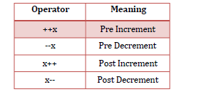
5: Increment And Decrement Operators: The increment and decrement operators are very useful. ++ and == are called increment and decrement operators used to add or subtract. Both are unary operators.
The syntax of the operators is given below.
These operators in two forms : prefix (++x) and postfix(x++).
++<variable name> --<variable name>
<variable name>++ <variable name> --
Where
1 : ++x : Pre increment, first increment and then do the operation.
2 : - -x : Pre decrement, first decrements and then do the operation.
3 : x++ : Post increment, first do the operation and then increment.
4 : x- - : Post decrement, first do the operation and then decrement.

Slide 85
public class Increment {
public static void main(String[] args)
{
int a = 20;
int b = 10;
System.out.println("Unary Operators");
System.out.println("++a = " + (++a));
System.out.println("a++ = " + (a++));
System.out.println("After a++ = " + a);
System.out.println("--b = " + (--b));
System.out.println("b-- = " + (b--));
System.out.println("After b-- = " + b);
}
}

Slide 86
6 : Conditional Operator: A conditional operator checks the condition and executes the statement depending on the condition. Conditional operator consists of two symbols.
: question mark (?).
: colon ( : ).
Syntax: condition ? exp1 : exp2;
It first evaluate the condition, if it is true (non-zero) then the “exp1” is evaluated, if the condition is false (zero) then the “exp2” is evaluated.
Example :
class ConditionalOperator
{
public static void main(String[] args)
{
int februaryDays = 29;
String result;
result = (februaryDays == 28) ? "Not a leap year" : "Leap year";
System.out.println(result);
}
}

Slide 87
import java.util.Scanner;
public class LeapYear {
public static void main(String[] args) {
Scanner sc = new Scanner(System.in);
System.out.print("Enter a year: ");
int year = sc.nextInt();
if ((year % 400 == 0) || (year % 4 == 0 && year % 100 != 0)) {
System.out.println(year + " is a Leap Year.");
} else {
System.out.println(year + " is Not a Leap Year.");
}
sc.close();
}
}
// If the year is divisible by 400, or It is divisible by 4 and not divisible by 100, then it is a Leap Year; otherwise, it is Not a Leap Year.

Slide 88
7. Bitwise Operators:
Bitwise operators are used for manipulating a data at the bit level, also called as bit level programming. Bit-level programming mainly consists of 0 and 1.
They are used in numerical Computations to make the calculation process faster.
The bitwise logical operators work on the data bit by bit.
Starting from the least significant bit, i.e. LSB bit which is the rightmost bit, working towards the MSB (Most Significant Bit) which is the leftmost bit.

Slide 89
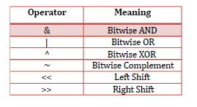
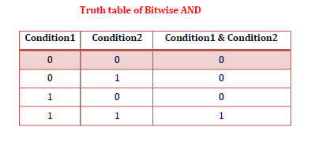
1. Bitwise AND (&):
Bitwise AND operator is represented by a single ampersand sign (&).
Two integer expressions are written on each side of the (&) operator.
if any one condition false ( 0 ) the complete condition becomes false ( 0 ).
Example : int x = 10;
int y = 20;
x & y = ?
x = 0000 1010
y = 0000 1011
x & y = 0000 1010 = 10

Slide 90
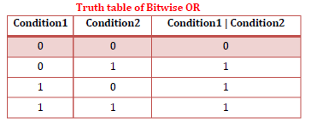
2. Bitwise OR:
Bitwise OR operator is represented by a single vertical bar sign (|).
Two integer expressions are written on each side of the (|) operator.
if any one condition true ( 1 ) the complete condition becomes true ( 1 )
Example : int x = 10;
int y = 20;
x | y = ?
x = 0000 1010
y = 0000 1011
x | y = 0000 1011 = 11

Slide 91
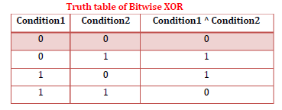
3. Bitwise Exclusive OR :
The XOR operator is denoted by a carrot (^) symbol.
It takes two values and returns true if they are different; otherwise returns false.
In binary, the true is represented by 1 and false is represented by 0.
Example : int x = 10;
int y = 20;
x ^ y = ?
x = 0000 1010
y = 0000 1011
x ^ y = 0000 0001 = 1

Slide 92
4. Bitwise Complement (~):
The bitwise complement operator is a unary operator.
It is denoted by ~, which is pronounced as tilde.
It changes binary digits 1 to 0 and 0 to 1.
bitwise complement of any integer
N is equal to - (N + 1).
Consider an integer 35. As per the rule, the bitwise complement of 35 should be
-(35 + 1) = -36.
Example : int x = 10; find the ~x value.
x = 0000 1010
~x= 1111 0101

Slide 93
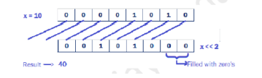
5. Bitwise Left Shift Operator ( << ) :
This Bitwise Left shift operator (<<) is a binary operator.
It shifts the bits of a number towards left a specified no. of times.
Example:
int x = 10;
x << 2 = ?

Slide 94
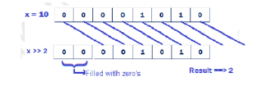
6. Bitwise Right Shift Operator ( >> ) :
This Bitwise Right shift operator (>>) is a binary operator.
It shifts the bits of a number towards right a specified no.of times.
Example:
int x = 10;
x >> 2 = ?

Slide 95
EXPRESSIONS
In any programming language, if we want to perform any calculation or to frame any condition etc., we use a set of symbols to perform the task. These set of symbols makes an expression.
In the java programming language, an expression is defined as follows..
An expression is a collection of operators and operands that represents a specific value.
In the above definition, an operator is a symbol that performs tasks like arithmetic operations, logical operations, and conditional operations, etc.
Expression Types
In the java programming language, expressions are divided into THREE types. They are as follows.
Infix Expression
Postfix Expression
Prefix Expression
The above classification is based on the operator position in the expression

Slide 96
Infix Expression
The expression in which the operator is used between operands is called infix expression. The infix expression has the following general structure.
Example
a+b
Postfix Expression
The expression in which the operator is used after operands is called postfix expression. The postfix expression has the following general structure.
Example
ab+
Prefix Expression
The expression in which the operator is used before operands is called a prefix expression. The prefix expression has the following general structure.
Example
+ab

Slide 97
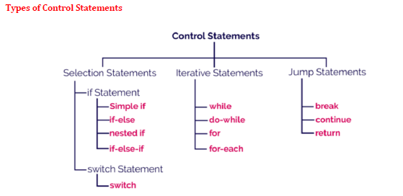
CONTROL STATEMENTS
In java, the default execution flow of a program is a sequential order, But the sequential order of execution flow may not be suitable for all situations.
Sometimes, we may want to jump from line to another line, we may want to skip a part of the program, or sometimes we may want to execute a part of the program again and again.
To solve this problem, java provides control statements.

Slide 98
The control statements are used to control over the
order of execution of the statements.
The two major types of control statements available in Java are the decision-making statements and the repetitive statements.
Decision-making Statements – if, if-else, switch
Repetitive statements – for, while, do-

Slide 99
1. Selection Control Statements
In java, the selection statements are also known as decision making statements or branching
statements. The selection statements are used to select a part of the program to be executed based on a
condition.
Java provides the following selection statements.
if statement
if-else statement
if-else-if statement
nested if statement
switch statement

Slide 100
Control Statements – if statement
The Java if statement tests the condition. It executes the if block if condition is true.
The syntax as follows
if(condition)
{
//code to be executed
}

Slide 101
Control Statements – if statement -
public class IfExample
{
public static void main(String[] args)
{
int age=20;
if(age>18)
{
System.out.print("Age is greater than 18");
}
}
Output:
}
Age is greater than 18

Slide 102
Control Statements – if-else
The Java if-else statement also tests the condition.
It executes the if block if condition is true otherwise else block is executed.
Syntax as follow:
if(condition)
{
//code if condition is true
}
else
{
//code if condition is false
}

Slide 103
Control Statements – if-else -
public class IfElseExample
{
public static void main(String[] args)
{
int number=13;
if(number%2==0)
{
System.out.println("even
number");
}
else
{
System.out.println("odd number");
}
}
}

Slide 104
Control Statements – if-else-if
The if-else-if statement executes one condition from multiple statements. The syntax as follows: if(condition1){
//code to be executed if condition1 is true
}else if(condition2){
//code to be executed if condition2 is true
}
else if(condition3){
//code to be executed if condition3 is true
}
...
else{
//code to be executed if all the conditions are false
}

Slide 105
Control Statements – if-else-if
public class IfElseIfExample
{
public static void main(String[] args)
{
int marks=65;
if(marks<50)
{
System.out.println("fail");
}
else if(marks>=50 && marks<60)
{
System.out.println("D grade");
}

Slide 106
Control Statements – if-else-if
else if(marks>=60 && marks<70)
{
System.out.println("C grade");
}
else if(marks>=70 && marks<80)
{
System.out.println("B grade");
}
else if(marks>=80 && marks<90)
{
System.out.println("A grade");
}

Slide 107
Control Statements – if-else-if
else if(marks>=90 && marks<100)
{
System.out.println("A+ grade");
}
else
{
System.out.println("Invalid!");
}
}
}

Slide 108
Control Statements – switch
The Java switch statement executes one statement from multiple conditions. It is like if-else- if ladder statement. The syntax as follows:
switch(expression)
{
case value1:
//code to be executed;
break; //optional
case value2:
//code to be executed;
break; //optional
......
default:
code to be executed if all cases are not matched;
}

Slide 109
public class SwitchExample
{
public static void main(String[] args)
{
int number=20;
switch(number)
{
case 10: System.out.println(“Ten"); break; case 20: System.out.println(“Twenty"); break; case 30: System.out.println(“Thirty"); break; default: System.out.println("Not in 10, 20 or
30");
}
}
}

Slide 110
Iterative/Looping Statements – for loop
The simple for loop is same as C/C++. We can initialize variable, check condition and increment/decrement value. The syntax as follows:
for(initialization; condition; incr/decr)
{
//code to be executed
}

Slide 111
Looping Statements – for loop -
public class ForExample {
public static void main(String[] args)
{
for(int i=1;i<=10;i++)
{
System.out.println(i); }
}
{
}
}

Slide 112
Looping Statements – for each
The for-each loop is used to traverse array or collection in java. It is easier to use than simple for loop because we don't need to increment value and use subscript notation.
It works on elements basis not index. It returns element one by one in the defined variable. The syntax as follows
for(Type var:array)
{
//code to be executed

Slide 113
Looping Statements – for each
public class ForEachExample
{
public static void main(String[] args)
{
int arr[]={12,23,44,56,78};
for(int i:arr)
{
System.out.println(i);
}
}
}

Slide 114
public class ForEach {
public static void main(String args[]) {
int nums[ ] = { 1, 2, 3, 4, 5, 6, 7, 8, 9, 10 };
int sum = 0;
// use for-each style for to display and sum the values
for(int x : nums)
{
System.out.println("Value is: " + x);
sum += x;
}
System.out.println("Summation: " + sum);
}
}

Slide 115
Looping Statements – While loop–Entry controlled
The Java while loop is used to iterate a part of the program several times. If the number of iteration is not fixed, it is recommended to use while loop.
Syntax:
while(condition)
{
//code to be executed
}

Slide 116
Example
public class WhileExample
{
public static void main(String[] args)
int i=1;
while(i<=10)
{
System.out.println(i); i++;
}
{
}
}

Slide 117
Looping Statements–do-while loop–Exit controlled
The Java do-while loop is used to iterate a part of the program several times.
If the number of iteration is not fixed and you must have to execute the loop at least once, it is recommended to use do-while loop.
The Java do-while loop is executed at least once
because conditionis checked after loop body. The syntax as follows:
do
{
statement(s)
} while (expression);

Slide 118
package oppsJavaProg;
public class DoWhileExample {
public static void main(String[] args) {
int i=1;
do
{
System.out.println(i); i++;
}while(i<=15);
}
}
{

Slide 119
Nested Loops
One loop may be inside another.
package oppsJavaProg;
public class Nested{
public static void main(String args[])
{
int i, j;
for(i=1; i<10; i++)
{
for(j=i; j<10; j++)
{
System.out.print("*");
}
System.out.println();
}
}
}

Slide 120
Jumping Statements – break statement
Unconditional Control Statements
The Java break is used to break loop or switch statement. It breaks the current flow of the program at specified condition. In case of inner loop, it breaks only inner loop.
Syntax:
jump-statement;
break;

Slide 121
Jumping Statements – break statement-
package oppsJavaProg;
public class BreakExample {
public static void main(String[] args)
{
for(int i=1;i<=10;i++)
{
if(i==5)
{
break;
}
System.out.println(i);
}
}
}

Slide 122
package oppsJavaProg;
public class BreakLoop {
public static void main(String args[]) {
for(int i=0; i<100; i++) {
if(i == 10) {
break; // terminate loop if i is 10
}
System.out.print(i+" ");
} System.out.print(" Loop complete.");
}
}

Slide 123
Jumping Statements – continue
The Java continue statement is used to continue loop. It continues the current flow of the program and skips the remaining code at specified condition. In case of inner loop, it continues only inner loop.
Syntax:
jump-statement;
continue;

Slide 124
public class ContinueExample
{
public static void main(String[] args)
{
for(int i=1;i<=10;i++)
{
if(i==5)
{
continue;
}
System.out.println(i);
}
}
}

Slide 125
return statement
In Java, the return statement is a jump statement that immediately terminates the execution of the current method and passes the control back to the calling method.
The return keyword is used in two ways, depending on whether the method returns a data value or is declared void
Syntax:-
return value; // Used in methods that have a specific return type
return; // Used in void methods to exit early

Slide 126
public class Calculatorreturn {
public static void main(String[] args) {
int outcome = addNumbers(10, 5); // Receives control and value back
System.out.println("Total: " + outcome);
}
public static int addNumbers(int a, int b) {
return a + b; // Instantly jumps back to main with the sum
}
}

Slide 127
TYPE CONVERSION AND CASTING
Type Casting
When a data type is converted into another data type by a programmer using the casting operator while writing a program code, the mechanism is known as type casting.
In typing casting, the destination data type may be smaller than the source data type when converting the data type to another data type, that’s why it is also called narrowing conversion.
But it is possible for conversion between incompatible types. To do so, you must use a cast, which performs an explicit conversion between incompatible types.
Syntax
destination_datatype = (target_datatype)variable;
(): is a casting operator.
target_datatype : is a data type in which we want to convert the source data type.
Example
float x;
byte y;
y=(byte)x;

Slide 128
public class NarrowingTypeCastingExample
{
public static void main(String args[])
{
double d = 166.66;
int i = (int)d;
//float f = 16.6f;
//int i = (int)f;
System.out.println("Before conversion: "+d);
System.out.println("After conversiontype: "+i);
}
}
Note:- A different type of conversion will occur when a floating-point value is assigned to an integer type: truncation.
As integers do not have fractional components so, when a floating-point value is assigned to an integer type, the fractional component is lost.

Slide 129
The Type Promotion Rules
Java defines several type promotion rules that apply to expressions. They are as follows:
First, all byte, short, and char values are promoted to int, as just described.
Then, if one operand is a long, the whole expression is promoted to long.
If one operand is a float, the entire expression is promoted to float.
If any of the operands is double, the result is double.

Slide 130
Type Conversion
If a data type is automatically converted into another data type at compile time is known as type conversion.
The conversion is performed by the compiler if both data types are compatible with each other.
Remember that the destination data type should not be smaller than the source type.
It is also known as widening conversion of the data type.
However, not all types are compatible, and thus, not all type conversions are implicitly allowed. For instance, there is no conversion defined from double to byte.
Example
int a = 20;
Float b;
b=a // Now the value variable b is 20.000

Slide 131
public class WideningTypeCastingExample
{
public static void main(String[] args)
{
int x = 7;
float y = x;
System.out.println("After conversion, float value "+y);
}
}

Slide 132
Classes and Objects
Class Characteristics
Identity - It is the name given to the class.
State - Represents data values that are associated with an object.
Behavior - Represents actions can be performed by an object.
Properties of Java Classes
1. Class is not a real-world entity. It is just a template or blueprint or prototype from which objects
are created.
2. Class does not occupy memory.
3. Class is a group of variables of different data types and a group of methods.
4. A Class in Java can contain:
Data member
Method
Constructor
Nested Class
Interface

Slide 133
Declaring Member Variables
There are several kinds of variables:
Member variables in a class—these are called fields.
Variables in a method or block of code—these are called local variables.
Variables in method declarations—these are called parameters.
Syntax to declare a class:
class <class_name>{
field;
method;
}

Slide 134
A class is declared by use of the class keyword
class classname
{
type instance-variable1;
type instance-variable2;
// ...
type instance-variableN;
type methodname1(parameter-list)
{
// body of method
}
type methodname2(parameter-list)
{
// body of method
}
// ...
type methodnameN(parameter-list)
{
// body of method
}
}

Slide 135
The data, or variables, defined within a class are called instance variables.
The code is contained within methods. Collectively, the methods and variables defined within a class are called members of the class.
Variables defined within a class are called instance variables.
Class demo {
int x=1;; int y=2; float z=3;
void display()
{
System.out.println(―values are:‖+x+--y+--z);
}
}

Slide 136
OBJECTS
An entity that has state and behavior is known as an object e.g. chair, bike, marker, pen, table, car etc. It can be physical or logical (tangible and intangible). The example of intangible object is banking system.
An object has three characteristics:
state: represents data (value) of an object.
behavior: represents the behavior (functionality) of an object such as deposit, withdraw etc.
identity: Object identity is typically implemented via a unique ID. The value of the ID is not visible to the external user. But, it is used internally by the JVM to identify each object uniquely.
For Example: Pen is an object.
Its name is Reynolds, color is white etc. known as its state. It is used to write, so writing is its behavior.

Slide 137
Object is an instance of a class. Class is a template or blueprint from which objects are created. So object is the instance(result) of a class.
All the objects that are created using a single class have the same properties and methods. But the value of properties is different for every object.
Object Definitions:
Object is a real world entity.
Object is a run time entity.
Object is an entity which has state and behavior.
Object is an instance of a class.

Slide 138
New keyword in Java
The new keyword is used to allocate memory at run time. All objects get memory in Heap memory area.
Syntax
ClassName objectName = new ClassName( );
The objectName must begin with an alphabet, and a Lower-case letter is preferred.
The objectName must follow all naming rules.
Example
Box mybox = new Box();
The new operator allocates memory for an object.

Slide 139
Declaring Objects
When you create a class, you are creating a new data type. You can use this type to declare objects of that type. However, obtaining objects of a class is a two-step process.
First, you must declare a variable of the class type. This variable does not define an object. Instead, it is simply a variable that can refer to an object.
Second, you must acquire an actual, physical copy of the object and assign it to that variable. You can do this using the new operator.
Syntax:- Demo d1 = new demo( );
class Student
{
int id;//field or data member or instance variable String name;
public static void main(String args[])
{
Student s1=new Student();//creating an object of Student System.out.println(s1.id);//accessing member through reference variable System.out.println(s1.name);
}
}

Slide 140
Three Ways to initialize object
There are 3 ways to initialize object in java
By reference variable
By method
By constructor
1) Object and Class Example: Initialization through reference
Initializing object simply means storing data into object. Let's see a simple example where we are going to initialize object through reference variable.
class Student{ int id;
String name;
}
class TestStudent2{
public static void main(String args[]){
Student s1=new Student();
s1.id=101;
s1.name=“Abc";
System.out.println(s1.id+" "+s1.name);// printing members with a white space
} }

Slide 141
TestStudent3.java
class Student{
int id;
String name; }
class TestStudent3{
public static void main(String args[]) {
Student s1=new Student();
Student s2=new Student();
s1.id=101; //Initializing object
s1.name=“abc";
s2.id=102; //Initializing object
s2.name="Amit";
System.out.println(s1.id+" "+s1.name); System.out.print(s2.id+" "+s2.name);
}
}

Slide 142
2) Object and Class Example: Initialization through method
In this example, we are creating the two objects of Student class and initializing the value to these objects by invoking the insertRecord method. Here, we are displaying the state (data) of the objects by invoking the displayInformation() method.
object gets the memory in heap memory area. The reference variable refers to the object allocated in the heap memory area. Here, s1 and s2 both are reference variables that refer to the objects allocated in memory.

Slide 143
class Std {
int rollNo;
String name;
void insert(int r, String n) {
rollNo = r;
name = n;
}
void display() {
System.out.println(rollNo + " " + name);
}
}
public class MethodInitialization {
public static void main(String[] args) {
Std s1 = new Std();
Std s2 = new Std();
s1.insert(101, "Rahul");
s2.insert(102, "Priya");
s1.display();
s2.display();
}
}

Slide 144
Constructors
A constructor is a special member of a class that is automatically called when an object is created. Its main purpose is to initialize the object's instance variables.
It has same name that of a class. A constructor initializes an object immediately upon creation.
A constructor has no return type; not even void.
It cannot be abstract, final, native ,static or synchronized.
this keyword refers another constructor in same class.
A super keyword will call constructor of super class constructors

Slide 145
Constructors are of two types:
1. Default constructor
2.Parameterised constructor
1. Default constructor:
A constructor that accepts no parameters is called default constructor.
If no constructor is defined for a class, java system automatically generates the default constructor.
A default constructor is called when an instance is created for a class.
The default constructor automatically initializes all instance variables to zero.
Syntax:- class ClassName {
ClassName() {
// Constructor body
}
}

Slide 146
class Student {
Student() {
System.out.println("Constructor is called");
}
}
Characteristics of a Constructor
The constructor name must be the same as the class name.
It does not have a return type.
It is called automatically when an object is created using new.
It is mainly used to initialize objects.
Constructors can be overloaded (multiple constructors with different parameter lists).
Constructors are used to:
Initialize object data.
Reduce repetitive code.
Ensure every object starts with valid values.
Allocate resources when an object is created.

Slide 147
class Student {
int rollNo;
String name;
Student() { // Default Constructor
rollNo = 05;
name = “ASDF";
}
void display() {
System.out.println(rollNo + " " + name);
}
}
public class DefaultConstructorDemo {
public static void main(String[] args) {
Student s1 = new Student();
s1.display();
}
}
main()
↓
new Student()
↓
Default Constructor
↓
Initialize Variables
↓
display()
↓
05 ASDF

Slide 148
class demo
{
int x,y; float z; demo()
{ x=1; y=2; z=3;
}
void display()
{
System.out.println("Values of x, y and z are:"+x+" "+y+" "+z);
}
}
public class Demomain
{
public static void main(String args[])
{
demo d1=new demo(); // this is a call for the above default
d1.display();
}
}

Slide 149
Parameterized constructor: A constructor that takes arguments as parameters is called as parameterized constructor
class demonstration
{
int x; int y; float z;
demonstration(int x1,int y1,int z1)
{
x=x1; y=y1; z=z1;
}
void display()
{ System.out.println("Values of x, y and z are:"+x+" "+y+" "+z);
}
}
class Demomain1
{
public static void main(String args[])
{
demonstration d1=new demonstration(1,2,3);
// this is a call for the above parameterized constructor
d1.display();
}
}

Slide 150
Constructor Overloading -A class can have multiple constructors with different parameter lists.
class Studentdemo {
int rollNo;
String name;
Studentdemo() {
rollNo = 0;
name = "Unknown"; }
Studentdemo(int r, String n) {
rollNo = r;
name = n; }
void display() {
System.out.println(rollNo + " " + name); }
}
public class ConstructorOverloadingDemo {
public static void main(String[] args) {
Studentdemo s1 = new Studentdemo();
Studentdemo s2 = new Studentdemo(101, "Rahul");
s1.display();
s2.display(); }
}

Slide 151
Java Copy Constructor
There is no copy constructor in java. But, we can copy the values of one object to another like copy constructor in C++. There are many ways to copy the values of one object into another in java. They are:
By constructor
By assigning the values of one object into another
By clone() method of Object class
class Student6{
int id; String name;
Student6(int i,String n){ id = i;
name = n;
}
Student6(Student6 s){ id = s.id;
name =s.name;
}

Slide 152
void display() {
System.out.println(id+" "+name);
}
public static void main(String args[])
{
Student6 s1 = new Student6(111,"Karan");
Student6 s2 = new Student6(s1);
s1.display();
s2.display();
}
}

Slide 153
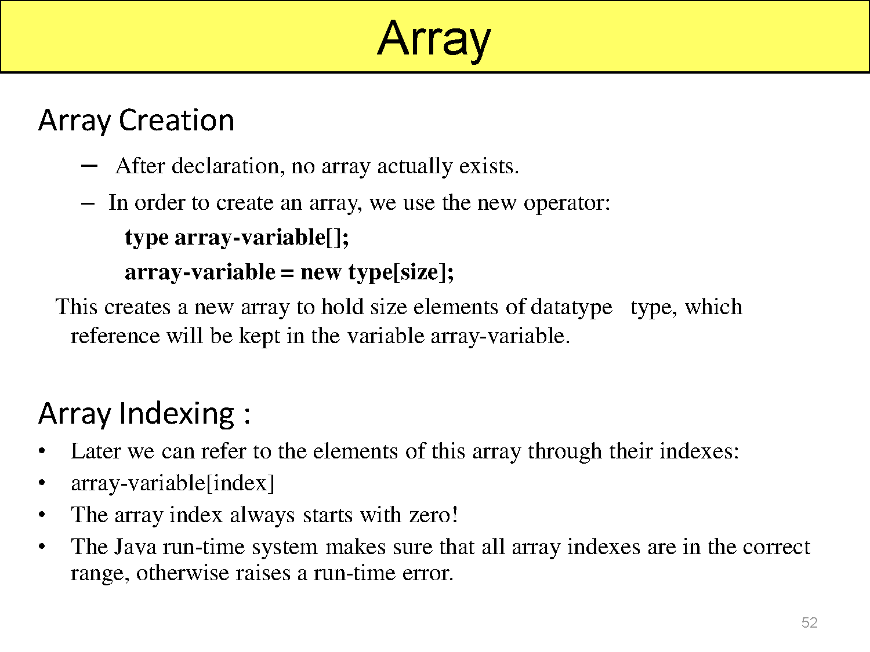

Slide 154
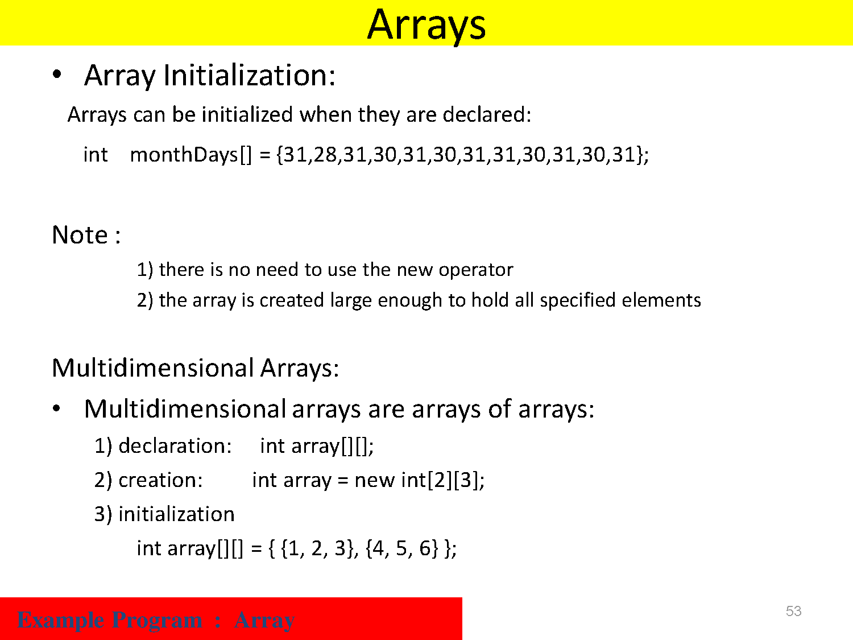

Slide 155
Operators
Operator in java is a symbol that is used to perform operations. For example: +, -, *, / etc.
There are many types of operators in java which are given below:
Unary Operator,
Arithmetic Operator,
shift Operator,
Relational Operator,
Bitwise Operator,
Logical Operator,
Ternary Operator and
Assignment Operator.
.

Slide 156
Operators
Operator Type | Category | Precedence
Unary | postfix | expr++ expr--
 | prefix | ++expr --expr +expr -expr ~ !
Arithmetic | multiplicative | * / %
 | additive | + -
Shift | shift | << >> >>>
Relational | comparison | < > <= >= instanceof
 | equality | == !=
Bitwise | bitwise AND | &
 | bitwise exclusive OR | ^
 | bitwise inclusive OR | |
Logical | logical AND | &&
 | logical OR | ||
Ternary | ternary | ? :
Assignment | assignment | = += -= *= /= %= &= ^= |= <<= >>= >>>=
.

Slide 157
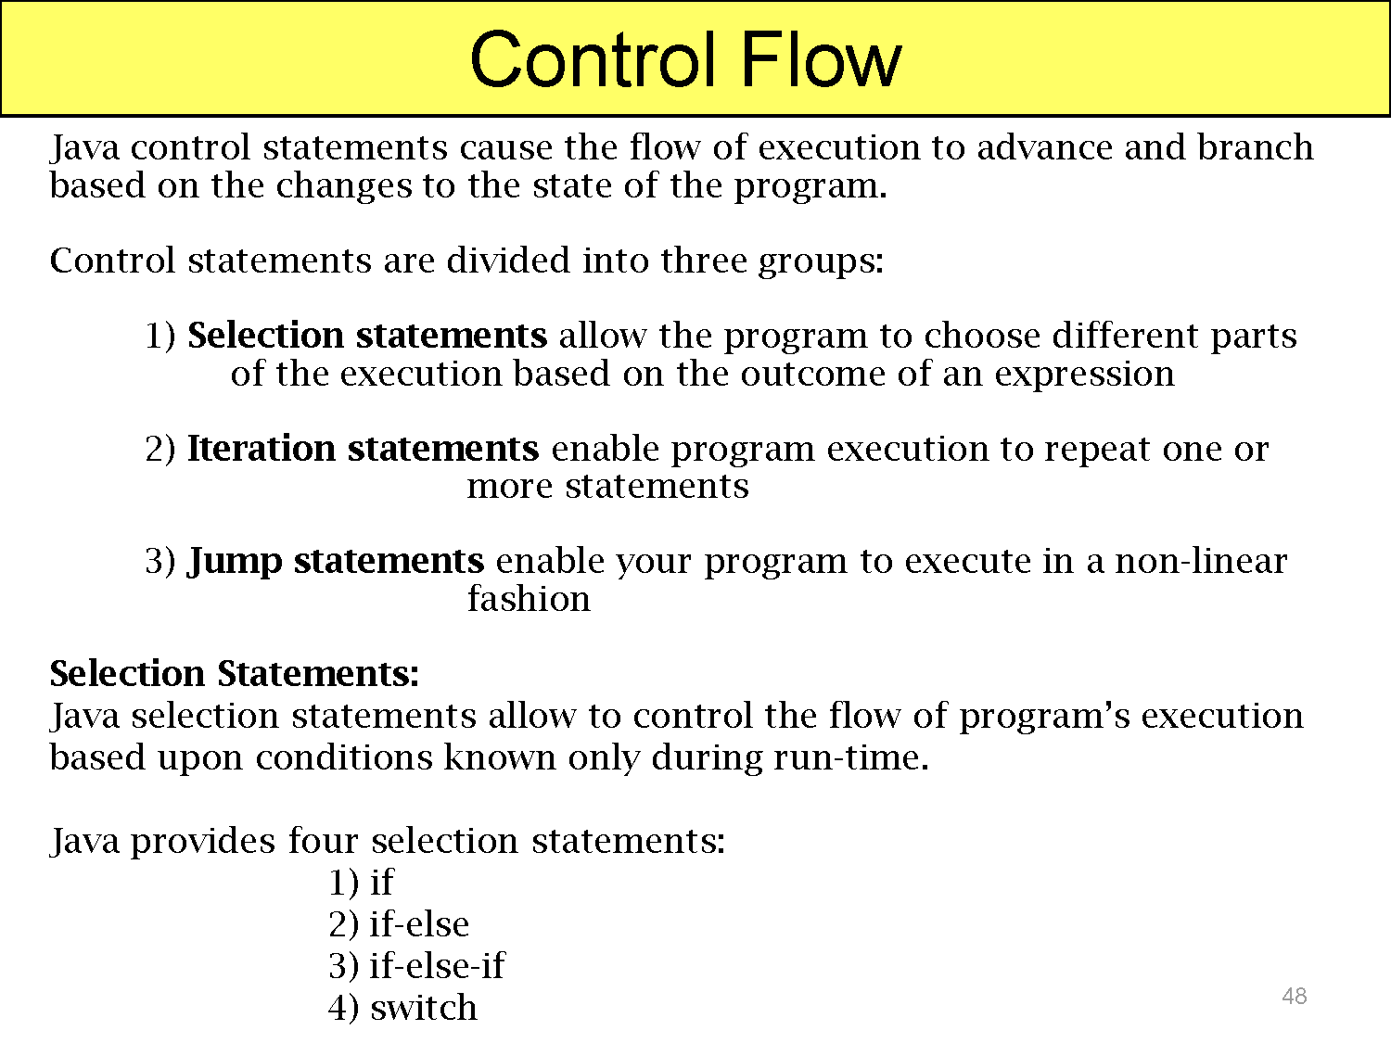

Slide 158
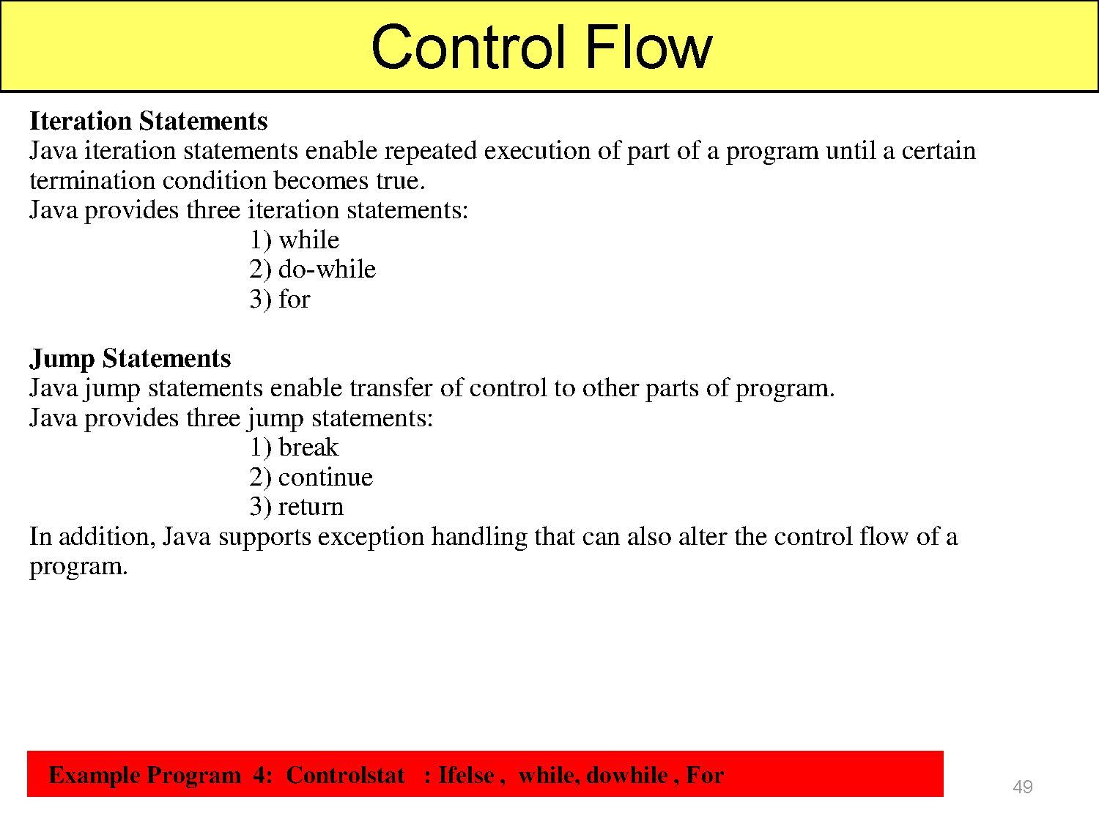

Slide 159
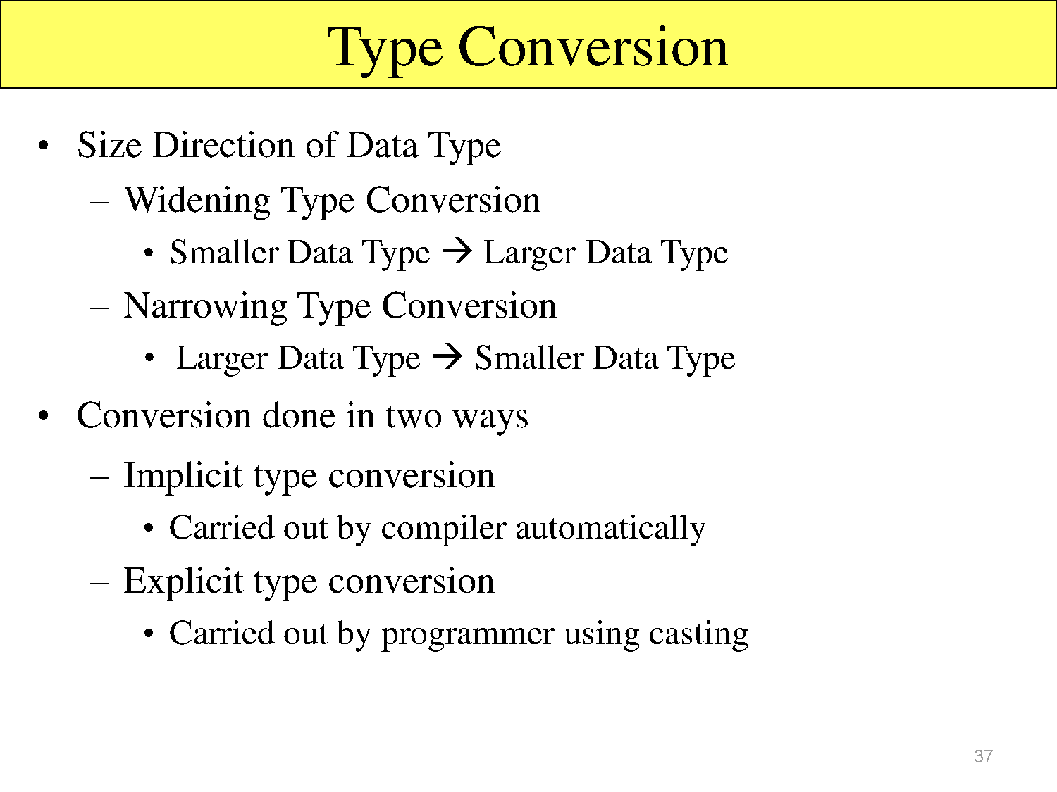

Slide 160
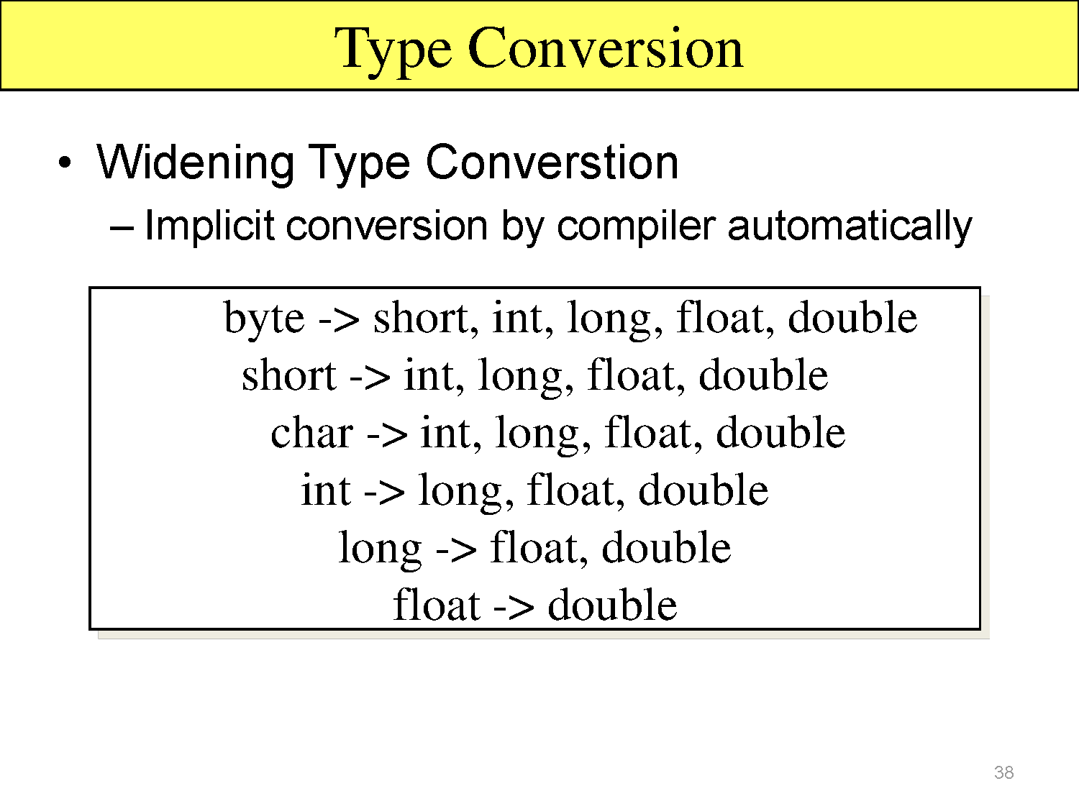

Slide 161
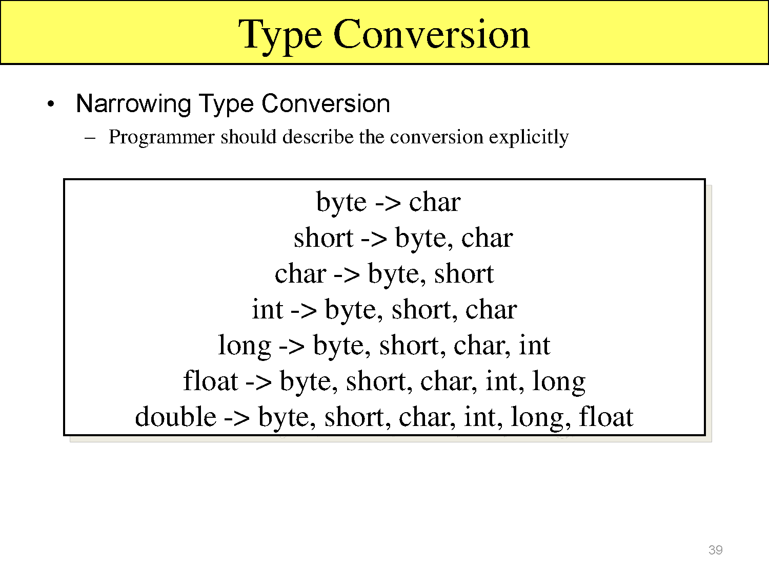

Slide 162
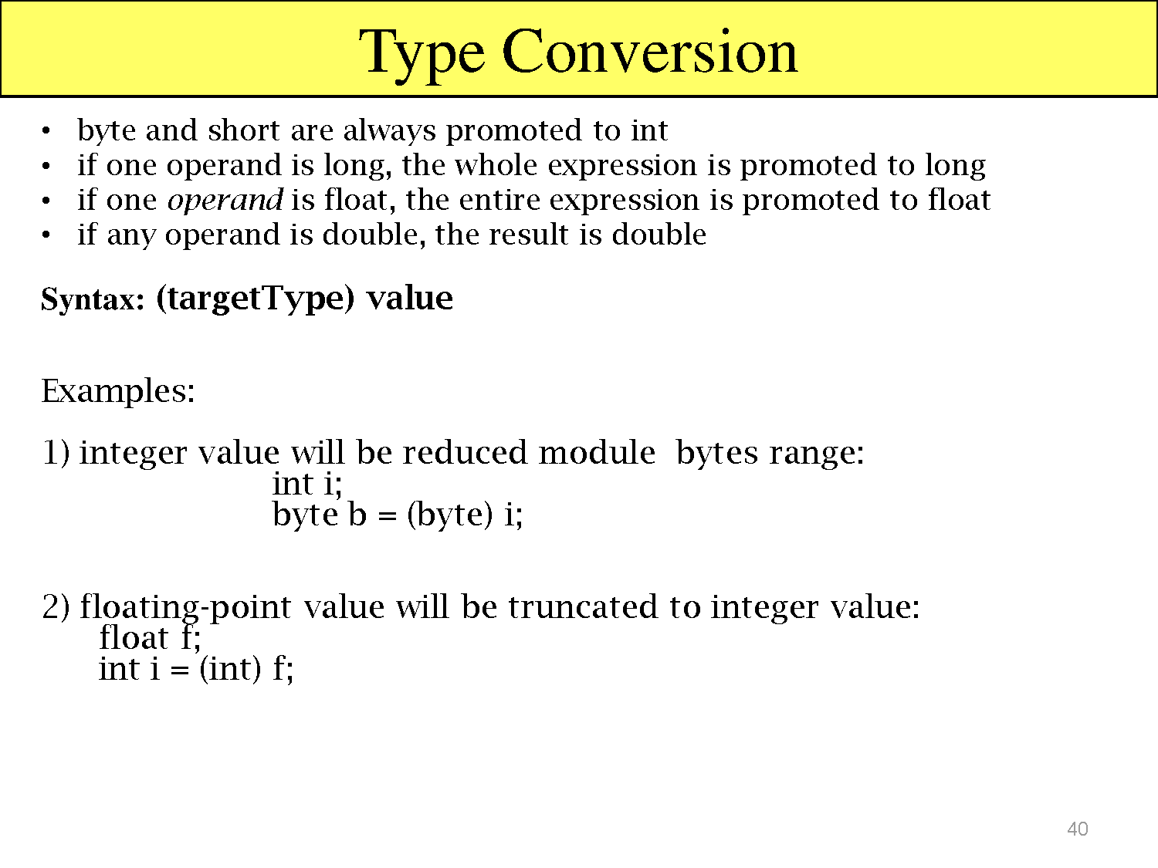

Slide 163
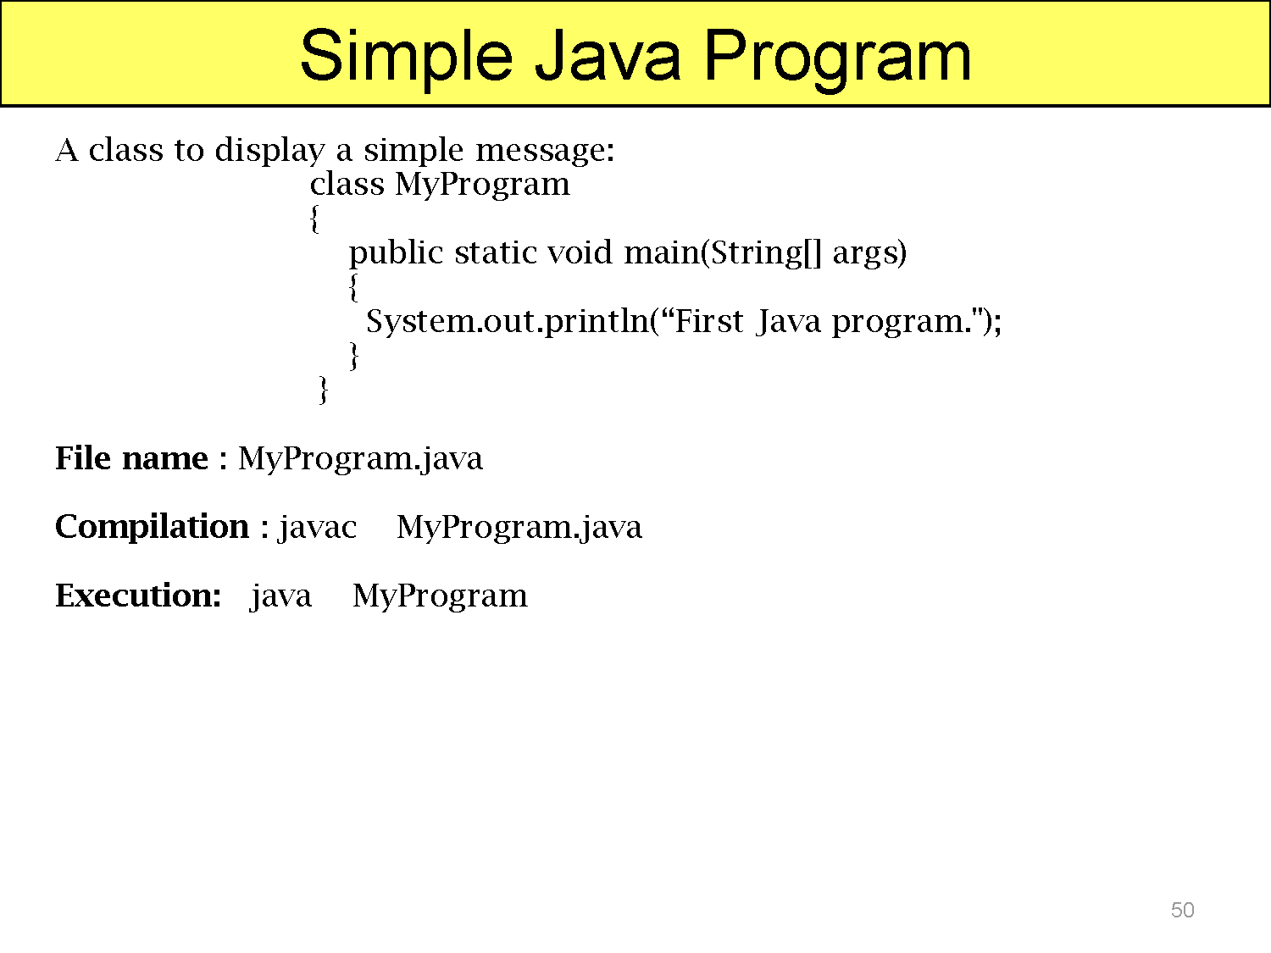

Slide 164


Slide 165


Slide 166


Slide 167


Slide 168


Slide 169


Slide 170


Slide 171
Static keyword
The static keyword in java is used for memory management mainly. We can apply java static keyword with variables, methods, blocks and nested class. The static keyword belongs to the class than instance of the class.
.

Slide 172
Static keyword
The static can be:
variable (also known as class variable)
method (also known as class method)
block
nested class
.

Slide 173
Static keyword
static variable
If you declare any variable as static, it is known static variable.
The static variable can be used to refer the common property of all objects (that is not unique for each object) e.g. company name of employees,college name of students etc.
.

Slide 174
Static keyword
The static variable gets memory only once in class area at the time of class loading.
Advantage:
It makes your program memory efficient (i.e it saves memory).
.
Refer Program Student.java

Slide 175
Static keyword
Java static method
If you apply static keyword with any method, it is known as static method.
A static method belongs to the class rather than object of a class.
A static method can be invoked without the need for creating an instance of a class.
Refer Program StaticMethod.java
.

Slide 176
Static keyword
static method can access static data member and can change the value of it.
Restrictions for static method
There are two main restrictions for the static method.
The static method can not use non static data member or call non-static method directly.
this and super cannot be used in static context.
.

Slide 177
Static keyword
Java static block
Is used to initialize the static data member.
It is executed before main method at the time of classloading.
.
Refer program A2.java

Slide 178
String Handling
Generally, string is a sequence of characters. But in java, string is an object that represents a sequence of characters. The java.lang.String class is used to create string object.
For example:
char[] ch={'j','a','v','a','t','p','o','i','n','t'};
String s=new String(ch);
same as
String s="javatpoint";
.

Slide 179
String Handling
Java String class provides a lot of methods to perform operations on string such as compare(), concat(), equals(), split(), length(), replace(), compareTo(), intern(), substring() etc.
How to create String object?
There are two ways to create String object:
By string literal
By new keyword
.

Slide 180
String Handling
1) String Literal
Java String literal is created by using double quotes.
For Example: String s="welcome";
.

Slide 181
String Handling
Each time you create a string literal, the JVM checks the string constant pool first. If the string already exists in the pool, a reference to the pooled instance is returned. If string doesn't exist in the pool, a new string instance is created and placed in the pool.
For example:
String s1="Welcome";
String s2="Welcome";//will not create new instance
.

Slide 182
String Handling
Why java uses concept of string literal?
To make Java more memory efficient (because no new objects are created if it exists already in string constant pool).
.
Example Program : String Example

Slide 183
String Handling
2) By new keyword:
String s=new String("Welcome");
In such case, JVM will create a new string object in normal(non pool) heap memory and the literal "Welcome" will be placed in the string constant pool. The variable s will refer to the object in heap(non pool).
.

Slide 184


Slide 185

Java StringBuffer class

Slide 186
String Handling
Java StringBuffer class: Java StringBuffer class is used to create mutable (modifiable) string. The StringBuffer class in java is same as String class except it is mutable i.e. it can be changed.
Constructor Description
StringBuffer() creates an empty string buffer
with the initial capacity of 16.
StringBuffer(String str) creates a string buffer
with the specified string.
StringBuffer(int capacity) creates an empty string
buffer with the specified
capacity as length.
.

Slide 187

String Handling
.

Slide 188
Java API
Java application programming interface (API) is a list of all classes that are part of the Java development kit (JDK). It includes all Java packages, classes, and interfaces, along with their methods, fields, and constructors. These prewritten classes provide a tremendous amount of functionality to a programmer.
.

Slide 189

Java API
.

Slide 190

Java API
.

